Slide 1
Introduction
Chapter-1

Slide 2
Outline
What is AI?
Foundation
A brief history
The state of the art

Slide 3
AI – Why so Important?
Homo sapiens—man the wise!

Slide 4
AI – Why so Important?...
For thousands of years, we have tried to understand how we think; that is, how a mere handful of matter can perceive, understand, predict, and manipulate a world far larger and more complicated than itself.
The field of artificial intelligence, or AI, goes further still: it attempts not just to understand but also to build intelligent entities.
AI is one of the newest fields in science and engineering. Work .started in earnest soon after World War II, and the name itself was coined in 1956
It is reasonably felt that all the good ideas have already been taken by Galileo, Newton, Einstein, and the rest. AI, on the other hand, still has openings for several full-time Einsteins and Edisons.

Slide 5
AI – Why so Important?...
AI currently encompasses a huge variety of subfields, ranging from the general (learning and perception) to the specific, such as playing chess, proving mathematical theorems, writing poetry, driving a car on a crowded street, and diagnosing diseases.
AI is relevant to any intellectual task; it is truly a universal field.

Slide 6
Introduction – Four Approaches to AI?
Systems that act like humans
Systems that think like humans
Systems that think rationally
Systems that act rationally
Systems that think like humans | Systems that think rationally
Systems that act like humans | Systems that act rationally

Slide 7
Introduction - What is AI ?(Contd…)

Slide 8
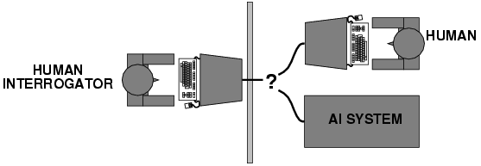
Acting humanly: The Turing Test
Alan Turing (1950) :“Computing machinery and intelligence":
“Can machines think?“ , “Can machines behave intelligently?"
Operational test for intelligent behavior: the Imitation Game
Predicted that by 2000, a machine might have a 30% chance of
fooling a lay person for 5 minutes.
Anticipated all major arguments against AI in following 50 years.
Suggested major components of AI: knowledge, reasoning, language understanding, learning.
------------------------------------------------------------------------------------------------------------
Problem: Turing test is not reproducible, constructive, or amenable to mathematical analysis.

Slide 9
Alan Turing’s first paper on AI
"Computing Machinery and Intelligence" is a seminal paper written by Alan Turing on the topic of artificial intelligence. The paper, published in 1950 in Mind, was the first to introduce his concept of what is now known as the Turing test to the general public.

Slide 10
Six Capabilities of a Computer to pass Total Turing Test
Natural Language Processing
Knowledge Representation
Automated Reasoning
Machine Learning
Computer Vision
Robotics

Slide 11
Thinking humanly: Cognitive modeling
1960’s "cognitive revolution": information-processing psychology
Requires scientific theories of internal activities of the brain
How to validate?
Requires
1) Predicting and testing behavior of human subjects
(or)
2) Direct identification from neurological data
Both approaches (roughly, Cognitive Science and Cognitive Neuroscience) are now distinct from AI

Slide 12
Cognitive Revolution
The cognitive revolution is the name for an intellectual movement in the 1950s that began what are known collectively as the cognitive sciences. It began in the modern context of greater interdisciplinary communication and research. The relevant areas of interchange were the combination of psychology, anthropology, and linguistics .
A key idea in cognitive psychology was that by studying and developing successful functions in artificial intelligence and computer science, it becomes possible to make testable inferences about human mental processes.

Slide 13
Thinking rationally: “Laws of thought"
Aristotle: what are correct arguments/thought processes?
Several Greek schools developed various forms of logic: notation and rules of derivation for thoughts; may or may not have proceeded to the idea of mechanization
Direct line through mathematics and philosophy to modern AI
Problems:
Not all intelligent behavior is mediated by logical deliberation
What is the purpose of thinking? What thoughts should I have?

Slide 14
Acting rationally: Rational agent
Rational behavior: doing the right thing
The right thing: that which is expected to maximize goal achievement, given the available information
Doesn't necessarily involve thinking – e.g., blinking reflex – but thinking should be in the service of rational action

Slide 15
Acting rationally: Rational agent (Contd.)
Aristotle (Nicomachean Ethics):
“Every art and every inquiry, and similarly every action and pursuit, is thought to aim at some good”

Slide 16
AI Foundation
Philosophy Logic, methods of reasoning, mind as physical system foundations of learning, language, rationality
Mathematics Formal representation and proof algorithms, computation, (un)decidability, (in)tractability, probability
Economics utility, decision theory
Neuroscience physical substrate for mental activity
Psychology phenomena of perception and motor control, experimental techniques
Computer building fast computers engineering
Control theory design systems that maximize an objective function over time
Linguistics knowledge representation, grammar

Slide 17
Abridged history of AI
1943 McCulloch & Pitts: Boolean circuit model of brain
1950 Turing's "Computing Machinery and Intelligence"
1956 Dartmouth meeting: "Artificial Intelligence" adopted
1952—69 Look, Ma, no hands!
1950s Early AI programs, including Samuel's checkers program, Newell & Simon's Logic Theorist, Gelernter's Geometry Engine
1965 Robinson's complete algorithm for logical reasoning
1966—73 AI discovers computational complexity Neural network research almost disappears
1969—79 Early development of knowledge-based systems
1980-- AI becomes an industry
1986-- Neural networks return to popularity
1987-- AI becomes a science
1995-- The emergence of intelligent agents

Slide 18
State of the art
Deep Blue defeated the reigning world chess champion Garry Kasparov in 1997
Proved a mathematical conjecture (Robbins conjecture) unsolved for decades
No hands across America (driving autonomously 98% of the time from Pittsburgh to San Diego)
During the 1991 Gulf War, US forces deployed an AI logistics planning and scheduling program that involved up to 50,000 vehicles, cargo, and people
NASA's on-board autonomous planning program controlled the scheduling of operations for a spacecraft
Proverb solves crossword puzzles better than most humans

Slide 19
State of the art
AI recently took the spotlight when IBM's Watson supercomputer routed human competitors on the game show Jeopardy.
But when it comes to AI, Watson is just the tip of the virtual frontal lobe. Labs across the United States and around the world are exploring much more than just ways to outwit Ken Jennings. Scientists are teaching robots to explore extraterrestrial planets and serve you coffee, cars are learning to drive themselves, computers are trying to assist doctors with medical diagnoses, and video game soldiers are training to do battle in a virtual theatre of war.

Slide 20
Applications of AI
AI has been used in a wide range of fields including medical diagnosis, stock trading, robot control, law, scientific discovery and toys. Many thousands of AI applications are deeply embedded in the infrastructure of every industry. It includes :

Slide 21
Applications of AI
1 Computer science
AI researchers have created many tools to solve the most difficult problems in computer science.
2 Finance
Banks use artificial intelligence systems to organize operations, invest in stocks, and manage properties. In August 2001, robots beat humans in a simulated financial trading competition.^{[4]}
Financial institutions have long used artificial neural network systems to detect charges or claims outside of the norm, flagging these for human investigation.
Creative Virtual has deployed artificial intelligence customer support systems, or automated online assistants, at E*TRADE, HSBC, Intuit and Lloyds Banking Group, to assist financial services customers with services such as checking an account balance, signing up for a new credit card or retrieving a forgotten password.

Slide 22
Applications of AI
3 Hospitals and medicine
A medical clinic can use artificial intelligence systems to organize bed schedules, make a staff rotation, and provide medical information.
Artificial neural networks are used as clinical decision support systems for medical diagnosis, such as in Concept Processing technology in EMR software.
Other tasks in medicine that can potentially be performed by artificial intelligence include:
Computer-aided interpretation of medical images. Such systems help scan digital images.

Slide 23
Applications of AI
4 Heavy industry
Robots have become common in many industries. They are often given jobs that are considered dangerous to humans. Robots have proven effective in jobs that are very repetitive which may lead to mistakes or accidents due to a lapse in concentration and other jobs which humans may find degrading. Japan is the leader in using and producing robots in the world. In 1999, 1,700,000 robots were in use worldwide.

Slide 24
Applications of AI
5 Online and telephone customer service
Artificial intelligence is implemented in automated online assistants that can be seen as avatars on web pages . It can avail for enterprises to reduce their operating and training cost . A major underlying technology to such systems is natural language processing.
Similar techniques may be used in answering machines of call centres , such as speech recognition software to allow computers to handle first level of customer support, text mining and natural language processing to allow better customer handling, agent training by automatic mining of best practices from past interactions, support automation and many other technologies to improve agent productivity and customer satisfaction.

Slide 25
Applications of AI
6 Transportation
Fuzzy logic controllers have been developed for automatic gearboxes in automobiles (the 2006 Audi TT, VW Toureg and VW Caravell feature the DSP transmission which utilizes Fuzzy Logic, a number of Škoda variants (Škoda Fabia) also currently include a Fuzzy Logic based controller).
7 Telecommunications
Many telecommunications companies make use of heuristic search in the management of their workforces, for example BT Group has deployed heuristic search in a scheduling application that provides the work schedules of 20,000 engineers.

Slide 26
Applications of AI
8 Toys and games
The 1990s saw some of the first attempts to mass-produce domestically aimed types of basic Artificial Intelligence for education, or leisure. This prospered greatly with the Digital Revolution, and helped introduce people, especially children, to a life of dealing with various types of Artificial Intelligence, specifically in the form of Tamagotchis and Giga Pets, the Internet (example: basic search engine interfaces are one simple form), and the first widely released robot, Furby. A mere year later an improved type of domestic robot was released in the form of Aibo, a robotic dog with intelligent features and autonomy. AI has also been applied to video games.
9 Music
The evolution of music has always been affected by technology. With AI, scientists are trying to make the computer emulate the activities of the skillful musician. Composition, performance, music theory, sound processing are some of the major areas on which research in Music and Artificial Intelligence are focusing.

Slide 27
Applications of AI
10 Aviation
The Air Operations Division AOD, uses AI for the rule based expert systems. The AOD has use for artificial intelligence for surrogate operators for combat and training simulators, mission management aids, support systems for tactical decision making, and post processing of the simulator data into symbolic summaries.
The use of artificial intelligence in simulators is proving to be very useful for the AOD. Airplane simulators are using artificial intelligence in order to process the data taken from simulated flights. Other than simulated flying, there is also simulated aircraft warfare. The computers are able to come up with the best success scenarios in these situations. The computers can also create strategies based on the placement, size, speed, and strength of the forces and counter forces. Pilots may be given assistance in the air during combat by computers.

Slide 28
Applications of AI
10 Aviation
The system used by the AOD in order to measure performance was the Interactive Fault Diagnosis and Isolation System, or IFDIS. It is a rule based expert system put together by collecting information from TF-30 documents and the expert advice from mechanics that work on the TF-30. This system was designed to be used to for the development of the TF-30 for the RAAF F-111C. The performance system was also used to replace specialized workers. The system allowed the regular workers to communicate with the system and avoid mistakes, miscalculations, or having to speak to one of the specialized workers.
The AOD also uses artificial intelligence in speech recognition software.
The Artificial Intelligence supported Design of Aircraft [1], or AIDA, is used to help designers in the process of creating conceptual designs of aircraft.

Slide 29
Applications of AI
11 News and publishing
The company Narrative Science makes computer generated news and reports commercially available, including summarizing team sporting events based on statistical data from the game. It also creates financial reports and real estate analyses.

Slide 30
Intelligent Agents Chapter-2

Slide 31
Outline
Agents and environments
Rationality
PEAS (Performance measure, Environment, Actuators, Sensors)
Environment types
Agent types

Slide 32
Agents
An agent is anything that can be viewed as perceiving its environment through sensors and acting upon that environment through actuators.
Human agent: eyes, ears, and other organs for sensors; hands, legs, mouth, and other body parts for actuators.
Robotic agent: cameras and infrared range finders for sensors; various motors for actuators.

Slide 33
Agents
Software agent ( SoftBot : software robot ) :-
receives keystrokes, file contents, network packets etc as sensory input.
acts on the environment by displaying on the screen, writing files, sending message packets.

Slide 34
Agent perception and action
Percept :- refers to an agents perceptual input at any given instant.
Percept sequence :- refers to the complete history of what an agent has perceived so far.
Action:- an agent’s choice of action at any given instant can depend on the entire percept sequence observed till that time.
Agent function:- an agent’s behavior is described by the agent function that maps any percept sequence to an action.

Slide 35
Agent

Slide 36
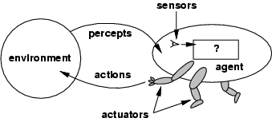
Agents and environments
The agent function maps from percept histories to actions: [f: P* → A]
The agent function is implemented by an agent program.
The agent program runs on the physical architecture to produce f
agent = architecture + program

Slide 37

Vacuum-cleaner world
Percepts: location and contents , e.g.,[ A, Dirty]
Actions: Left, Right, Suck, NoOp Percept sequence : Action :
[A, Clean] right
[A, Dirty] suck
[B, Clean] left
[B, dirty] suck
[A, Dirty],[A, Clean] right
……………

Slide 38
Rational agents
An agent should strive to "do the right thing", based on what it can perceive and the actions it can perform. The right action is the one that will cause the agent to be most successful.
Performance measure: An objective criterion for success of an agent's behavior.
E.g., performance measure of a vacuum-cleaner agent could be the amount of dirt cleaned up, the amount of time taken, the amount of electricity consumed, the amount of noise generated, etc .

Slide 39
RATIONALITY
Rationality at any given time depends on :
Agent’s prior knowledge of the environment.
Actions that the agent can perform.
Agent’s percept sequence till that moment.
The performance measure that defines the criterion of success.

Slide 40
Rational agents
Rational Agent: For each possible percept sequence, a rational agent should select an action that is expected to maximize its performance measure, given the evidence provided by the percept sequence and whatever built-in knowledge the agent has.

Slide 41
Requirements for a Rational agent
Rationality ; which is distinct from omniscience (all-knowing with infinite knowledge)
Information gathering capability ; Agents can perform actions in order to modify future percepts so as to obtain useful information. Learning ability.
Ability to adapt.
An agent is autonomous if its behavior is determined by its own experience (with ability to learn and adapt)

Slide 42
Building intelligent agents
An agent is completely specified by the agent function which maps percept sequences to action.
An agent has some internal data structures that is updated as and when new percepts arrive.
The data structures are operated on by the agent’s decision making procedures to generate an action choice, which is then passed to the architecture to get executed.

Slide 43
Building intelligent agents
An agent consists of an architecture plus a program that runs on that architecture.
In designing intelligent systems , there are 4 main factors to consider:-
Percepts:- the inputs to our system.
Actions:- the outputs of our system.
Goals:- what the agent is expected to achieve.
Environment:- what the agent is interacting with.

Slide 44
PEAS
Task environments are problems to which rational agents are the solutions. The task environment is specified by PEAS.
PEAS stands for :- Performance measure, Environment, Actuators, Sensors.
PEAS specifies the settings for an intelligent agent design.

Slide 45
PEAS
Consider, e.g., the task of designing an automated taxi driver:
Performance measure: Safe, fast, legal, comfortable trip, maximize profits.
Environment: Roads, other traffic, pedestrians, customers.
Actuators: Steering wheel, accelerator, brake, signal, horn.
Sensors: Cameras, sonar, speedometer, GPS, odometer, engine sensors, keyboard.

Slide 46
PEAS
Agent: Medical diagnosis system
Performance measure: Healthy patient, minimize costs, lawsuits
Environment: Patient, hospital, staff
Actuators: Screen display (questions, tests, diagnoses, treatments, referrals)
Sensors: Keyboard (entry of symptoms, findings, patient's answers)

Slide 47
PEAS
Agent: Part-picking robot
Performance measure: Percentage of parts in correct bins
Environment: Conveyor belt with parts, bins
Actuators: Jointed arm and hand
Sensors: Camera, joint angle sensors

Slide 48
PEAS
Agent: Interactive English tutor
Performance measure: Maximize student's score on test
Environment: Set of students
Actuators: Screen display (exercises, suggestions, corrections)
Sensors: Keyboard

Slide 49
Environment types
Fully observable (vs. partially observable): An agent's sensors give it access to the complete state of the environment at each point in time.
Fully observable vs. Partially observable
If an agent’s sensors give it access to the complete state of the environment at each point in time then the environment is effectively fully observable
if the sensors detect all aspects
That are relevant to the choice of action

Slide 50
Environment Types
Partially observable
An environment might be Partially observable because of noisy and inaccurate sensors or because parts of the state are simply missing from the sensor data.
Example:
Only a local dirt sensor of the cleaner without a location detection sensor cannot tell whether other squares are clean or not.

Slide 51
Environment Types
Deterministic vs. stochastic
Next state of the environment Completely determined by the current state and the actions executed by the agent, then the environment is deterministic, otherwise, it is Stochastic.
Strategic environment: deterministic except for actions of other agents
-Cleaner and taxi driver are:
Stochastic because of some unobservable aspects → noise or unknown

Slide 52
Environment Types
Episodic (vs. sequential): The agent's experience is divided into atomic "episodes" (each episode consists of the agent perceiving and then performing a single action), and the choice of action in each episode depends only on the episode itself.

Slide 53
Environment types
Static (vs. dynamic): The environment is unchanged while an agent is deliberating. (The environment is semi dynamic if the environment itself does not change with the passage of time but the agent's performance score does)
Discrete (vs. continuous): A limited number of distinct, clearly defined percepts and actions.
Single agent (vs. multiagent): An agent operating by itself in an environment.

Slide 54
Environment Types

Slide 55
Environment types (Contd…)
The environment type largely determines the agent design
The real world is (of course) partially observable, stochastic, sequential, dynamic, continuous, multi-agent

Slide 56
ENVIRONMENT CLASS
A number of environments are implemented, together with a general-purpose environment simulator that places one or more agents in a simulated environment, observes their behavior over time, and evaluates them according to a given performance measure. Such experiments are often carried out not for a single environment but for many environments drawn from an environment class.
For example, to evaluate a taxi driver in simulated traffic, we would want to run many simulations with different traffic, lighting, and weather conditions. If we designed the agent for a single scenario, we might be able to take advantage of specific properties of the particular case but might not identify a good design for driving in general.

Slide 57
ENVIRONMENT GENERATOR
An environment generator for each environment class that selects particular environments (with certain likelihoods) in which to run the agent.
For example, the vacuum environment generator initializes the dirt pattern and agent location randomly. We are then interested in the agent’s average performance over the environment class. A rational agent for a given environment class maximizes this average performance.

Slide 58
Agent functions and programs
An agent is completely specified by the agent function mapping percept sequences to actions.
Agent program implements agent function using agent architecture.
Input to agent program is the current percept whereas agent function takes the percept history as input.

Slide 59
Table Driven Agent
function TABLE-DRIVEN-AGENT(percept ) returns an action
persistent: percepts, a sequence, initially empty
table, a table of actions, indexed by percept sequences, initially fully specified
append percept to the end of percepts
action ←LOOKUP(percepts, table)
return action

Slide 60
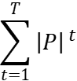
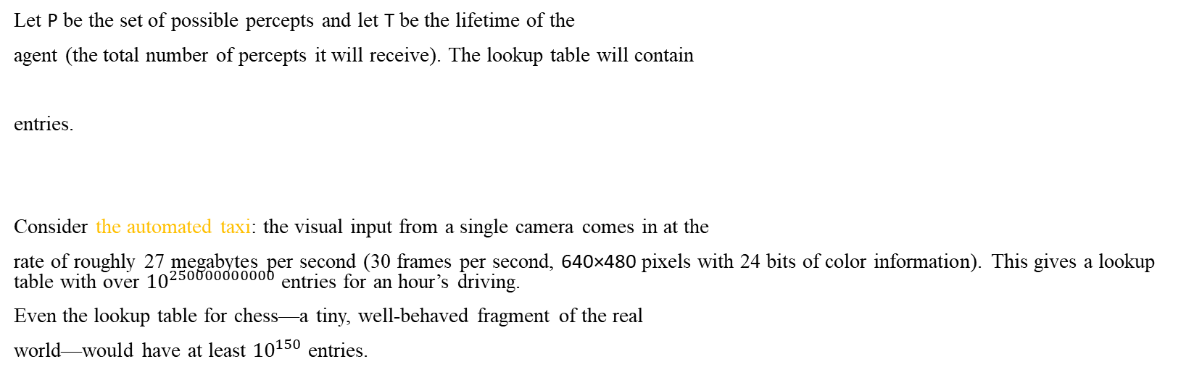
Examples of Table Driven Agent
Let P be the set of possible percepts and let T be the lifetime of the
agent (the total number of percepts it will receive). The lookup table will contain
entries.
Consider the automated taxi: the visual input from a single camera comes in at the
rate of roughly 27 megabytes per second (30 frames per second, 640×480 pixels with 24 bits of color information). This gives a lookup table with over ${10}^{250000000000}$entries for an hour’s driving.
Even the lookup table for chess—a tiny, well-behaved fragment of the real
world—would have at least ${10}^{150}$ entries.

Slide 61
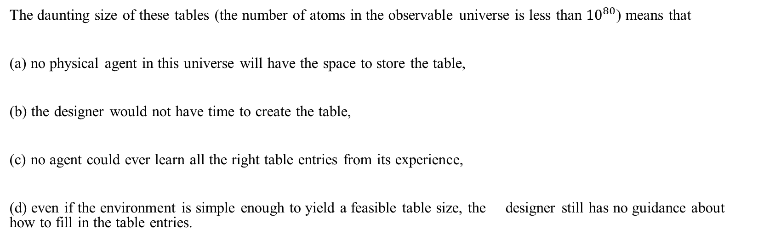
Table Driven Agent: A Failure
The daunting size of these tables (the number of atoms in the observable universe is less than ${10}^{80}$) means that
(a) no physical agent in this universe will have the space to store the table,
(b) the designer would not have time to create the table,
(c) no agent could ever learn all the right table entries from its experience,
(d) even if the environment is simple enough to yield a feasible table size, the designer still has no guidance about how to fill in the table entries.

Slide 62
Agent types
Four basic types of agents in order of increasing sophistication:
Simple reflex agents
Model-based reflex agents
Goal-based agents
Utility-based agents

Slide 63
Simple reflex agents
It works by finding a rule whose condition matches the current situation ( as defined by the percept ) and then doing the action associated with that rule.
A set of condition ~ action rules / situation ~ action rules / productions / if~ then rules are defined.
e.g if the car – in - front is braking
then initiate – braking
This agent function only succeeds when the environment is fully observable.

Slide 64
A Simple Reflex Agent: In the two-state vacuum environment
The agent program for a simple reflex agent in the two-state vacuum environment:
function REFLEX-VACUUM-AGENT([location, status]) returns an action
if status = Dirty then return Suck
else if location = A then return Right
else if location = B then return Left

Slide 65
A Simple Reflex Agent with Internal State: In the two-state vacuum environment
function REFLEX-VACUUM-AGENT([location, status]) returns an action
static: remind, keeps track of clean status, initially zero
if status = Dirty then return Suck
else if (location = A and remind<1) then
{
remind=remind +1
return Right
}
else if (location = B and remind<1)then
{
remind=remind+1
return Left
}
else return NOP

Slide 66
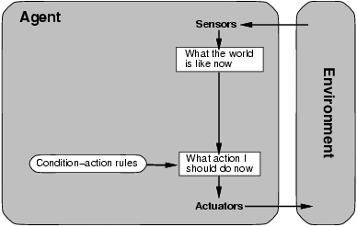
Simple reflex agents

Slide 67
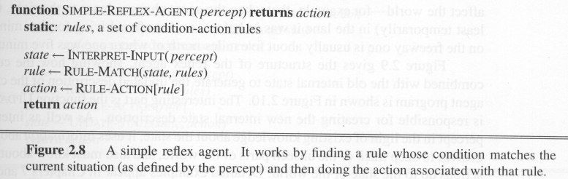

Slide 68
A Simple Reflex Agent in Nature
percepts
(size, motion)
RULES:
(1) If small moving object,
then activate SNAP
(2) If large moving object,
then activate AVOID and inhibit SNAP
ELSE (not moving) then NOOP
needed for
completeness
Action: SNAP or AVOID or NOOP

Slide 69
Model-based reflex agents
Model based agents can handle partially observable environments.
Its current state is stored inside the agent maintaining some kind of structure which describes the part of the world which can’t be seen. This behavior requires information on how the world behaves and works. This additional information completes the “world view” model.

Slide 70
Model-based reflex agents
A model – based reflex agent keeps track of the current state of the world using an internal model. It then chooses an action in the same way as the reflex agent.
The state changes whenever an action is performed or something is perceived in the environment.

Slide 71
Model-based reflex agents
For the world that is partially observable
the agent has to keep track of an internal state
That depends on the percept history
Reflecting some of the unobserved aspects
E.g., driving a car and changing lane
Requiring two types of knowledge
How the world evolves independently of the agent
How the agent’s actions affect the world

Slide 72
Example Table Agent With Internal State
IF
THEN
Saw an object ahead, and turned right, and it’s now clear ahead | Go straight
Saw an object Ahead, turned right, and object ahead again | Halt
See no objects ahead | Go straight
See an object ahead | Turn randomly

Slide 73
Example Reflex Agent With Internal State: Wall-Following
start
Actions: left, right, straight, open-door
Rules:
If open(left) & open(right) and open(straight) then choose randomly between right and left
If wall(left) and open(right) and open(straight) then straight
If wall(right) and open(left) and open(straight) then straight
If wall(right) and open(left) and wall(straight) then left
If wall(left) and open(right) and wall(straight) then right
If wall(left) and door(right) and wall(straight) then open-door
If wall(right) and wall(left) and open(straight) then straight.
(Default) Move randomly

Slide 74
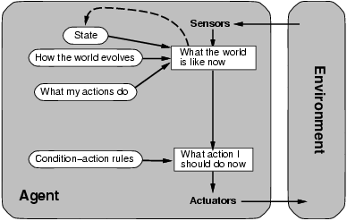
Model-based reflex agents

Slide 75
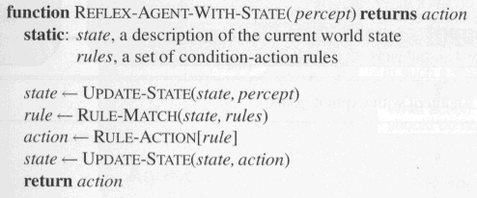
Model-based Reflex Agents
The agent is with memory

Slide 76
Goal based agents
Knowing about the current state of the environment is not always enough to decide what to do; additionally sort of goal information which describes situations that are desirable is also required. This allows the agent a way to choose among multiple possibilities , selecting the one which reaches a goal state.

Slide 77
Goal-based agents
Current state of the environment is always not enough
The goal is another issue to achieve
Judgment of rationality / correctness
Actions chosen → goals, based on
the current state
the current percept

Slide 78
Goal-based agents
Conclusion
Goal-based agents are less efficient
but more flexible
Agent ← Different goals ← different tasks
Search and planning
two other sub-fields in AI
to find out the action sequences to achieve its goal

Slide 79
A model based - Goal based agent
It keeps track of the world state and a set of goals it is trying to achieve and picks an action that will eventually lead to the achievement of its goal.

Slide 80
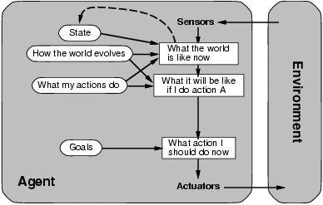
Goal-based agents

Slide 81
Utility based agents
Goal based agents only distinguish between goal states and non-goal states.
It is possible to define a measure of how desirable a particular state is. This measure can be obtained through the use of a utility function which maps a state to a measure of the utility of the state. So, utility function maps a state onto a real number, which describes the associated degree of happiness.
A complete specification of the utility function allows rational decisions.

Slide 82
Utility-based agents
Goals alone are not enough
to generate high-quality behavior
E.g. meals in Canteen, good or not ?
Many action sequences → the goals
some are better and some worse
If goal means success,
then utility means the degree of success (how successful it is)

Slide 83
Utility-based agents
it is said state A has higher utility
If state A is more preferred than others
Utility is therefore a function
that maps a state onto a real number
the degree of success

Slide 84
Utility-based agents
Utility has several advantages:
When there are conflicting goals,
Only some of the goals but not all can be achieved
utility describes the appropriate trade-off
When there are several goals
None of them are achieved certainly
utility provides a way for the decision-making

Slide 85
A model based-utility based agent
It uses a model of the world along with a utility function that measures its preferences among states of the world. Then it chooses an action that leads to the best expected utility.

Slide 86
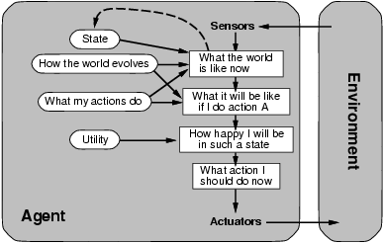
Utility-based agents

Slide 87
Learning Agents
After an agent is programmed, can it work immediately?
No, it still need teaching
In AI,
Once an agent is done
We teach it by giving it a set of examples
Test it by using another set of examples
We then say the agent learns
A learning agent

Slide 88
Learning Agents
Four conceptual components
Learning element
Making improvement
Performance element
Selecting external actions
Critic
Tells the Learning element how well the agent is doing with respect to fixed performance standard.
(Feedback from user or examples, good or not?)
Problem generator
Suggest actions that will lead to new and informative experiences.

Slide 89
Learning agents
Learning has an advantage that it allows the agents to initially operate in unknown environments and to become more competent than its initial knowledge alone might allow.

Slide 90
Learning agents
Components:-
Learning element:- responsible for making improvements.
Performance elements:- responsible for selecting actions.
Critics:- provides feedback
Problem generator:- responsible for suggesting actions that will lead to new experiences.

Slide 91
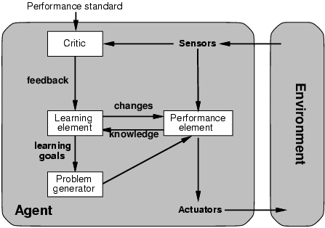
Learning agents

Slide 92
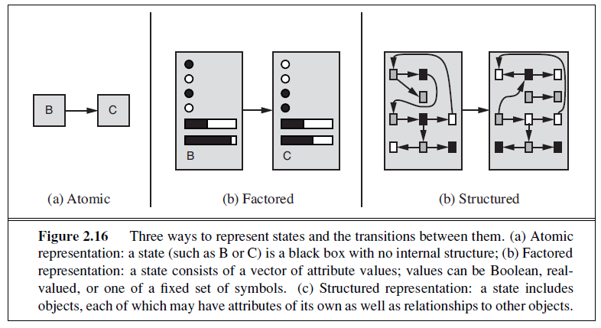
Representation of States

Slide 93
Solving problems by searching
Chapter 3

Slide 94
Outline
Problem-solving agents
Problem types
Problem formulation
Example problems
Basic search algorithms

Slide 95
Problem solving agent
A problem can be defined or formulated formally by 4 components:-
Initial state :- Describes possible initial state from where problem solving agent starts in.
A set of actions and Successor Function:- Given a particular state x, Successor Function (SF (x)) returns a set of <action, successor> ordered pairs, where each action is one of the legal actions in state x and each successor is a state that can be reached from x by applying the action.
Together, the initial state and successor function implicitly define the state space of the problem i.e. the set of all states reachable from the initial state.
Initial state + SF => state space

Slide 96
Problem solving …..
State space forms a graph in which the nodes are states and the arcs between nodes are actions. (It defines all the possible configurations of the relevant objects associated with the problem.)
Goal test :- It determines whether a given state is a goal state.
Path cost :- A path in the state space is a sequence of states connected by a sequence of actions. A path cost function assigns a numeric cost to each path. The problem-solving agent chooses a cost function that reflects its own performance measure.
Path cost = ∑Step costs => Sum of the costs of the individual actions along the path.
(Step cost of taking action a to go from state x to state y is denoted by c(x, a, y) )

Slide 97
Problem solving…
These four components that define a problem can be gathered together into a single data structure that is given as input to a problem-solving algorithm.
A solution to a problem is a path from the initial state to a goal state.
Solution quality is measured by the path cost function, and an optimal solution has the lowest path cost among all solutions.

Slide 98
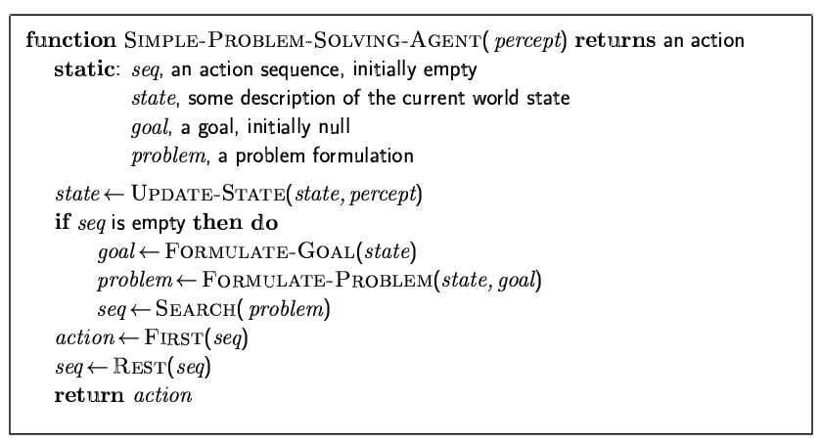
Problem-solving agents

Slide 99
Example: Romania
On holiday in Romania; currently in Arad.
Formulate goal:
To be in Bucharest
Formulate problem:
states: various cities
actions: drive between cities
Find solution:
sequence of cities, e.g., Arad, Sibiu, Fagaras, Bucharest

Slide 100
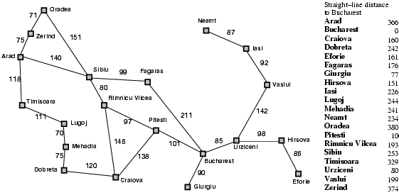
Romania with step costs in km

Slide 101
Selecting a state space
Real world is absurdly complex
→ state space must be abstracted for problem solving
(Abstract) state = set of real states
(Abstract) action = complex combination of real actions
e.g., "Arad → Zerind" represents a complex set of possible routes, detours, rest stops, etc.
For guaranteed realizability, any real state "in Arad“ must get to some real state "in Zerind"
(Abstract) solution =
set of real paths that are solutions in the real world
Each abstract action should be "easier" than the original problem

Slide 102
Problem formulation for Toy problems
Simple vacuum world problem
8 – puzzle problem (or Sliding block problem)
8 – queen problem
Knuth number generation problem

Slide 103
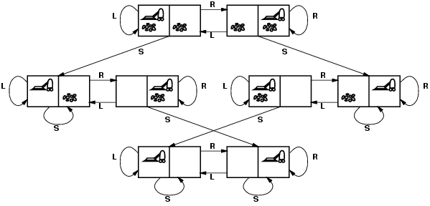
Simple vacuum world problem (State space graph)
states?
actions?
goal test?
path cost?

Slide 104
Simple vacuum world problem (State space graph)…
states? dirt and location
actions? Left, Right, Suck
goal test? no dirt at all locations
path cost? 1 per action

Slide 105

The 8-puzzle problem
states?
actions?
goal test?
path cost?

Slide 106
The 8-puzzle problem…
states? locations of tiles
actions? move blank left, right, up, down
goal test? = goal state (given)
path cost? 1 per move
[Note: optimal solution of n-Puzzle family is NP-hard]

Slide 107
8-Queen problem
There are two main kinds of formulation. An incremental formulation involves operators that augment the state description, starting with an empty state; for the 8-queens problem, this means that each action adds a queen to the state. A complete-state formulation starts with all 8 queens on the board and moves them around. In either case, the path cost is of no interest because only the final state counts. The first incremental formulation one might try is the following:

Slide 108
8-Queen problem…

Slide 109
Knuth’ s Number Generation

Slide 110
Problem formulation for Real world problems
The route-finding problem is defined in terms of specified locations and transitions along links between them.
Route-finding algorithms are used in a variety of applications.
Some, such as Web sites and in-car systems that provide driving directions, are relatively straightforward extensions of the Romania example.
Others, such as routing video streams in computer networks, military operations planning, and airline travel-planning
systems, involve much more complex specifications.

Slide 111
Airline Travel Problem
Consider the airline travel problem that must be solved by a travel-planning Web site:
• States: Each state obviously includes a location (e.g., an airport) and the current time. Furthermore, because the cost of an action (a flight segment) may depend on previous segments, their fare bases, and their status as domestic or international, the state must record extra information about these “historical” aspects.
• Initial state: This is specified by the user’s query.
• Actions: Take any flight from the current location, in any seat class, leaving after the current time, leaving enough time for within-airport transfer if needed.
• Transition model: The state resulting from taking a flight will have the flight’s destination as the current location and the flight’s arrival time as the current time.
• Goal test: Are we at the final destination specified by the user?
• Path cost: This depends on monetary cost, waiting time, flight time, customs and immigration procedures, seat quality, time of day, type of airplane, frequent-flyer mileage awards, and so on.

Slide 112
Some but not exhaustive list of Real world problems
Touring problems
Traveling salesperson problem (TSP)
VLSI layout problem
Robot navigation
Automatic assembly sequencing
Protein design

Slide 113
Basic AI problem solving techniques
Problem solving by searching
Problem solving by Reasoning / Inference
Problem solving by Matching

Slide 114
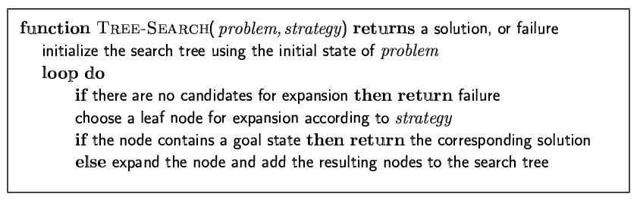
Informal Tree search algorithm
Basic idea:
offline, simulated exploration of state space by generating successors of already-explored states (a.k.a.~expanding states)

Slide 115
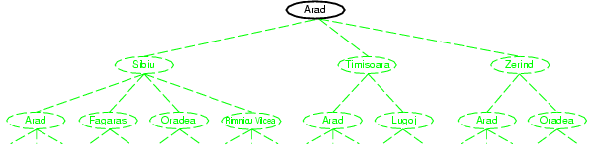
Tree search example

Slide 116
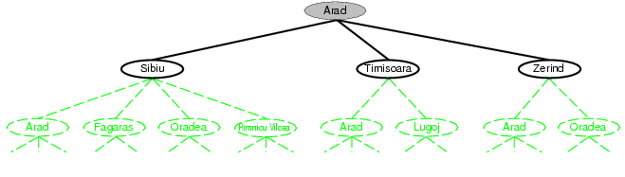
Tree search example

Slide 117
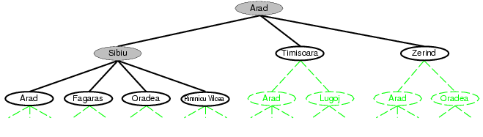
Tree search example

Slide 118
Informal Graph search algorithms

Slide 119
Some examples of Graph search

Slide 120
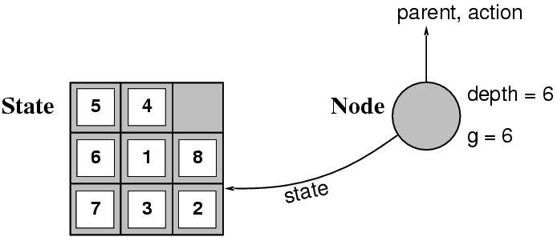
State vs. node
A state is a (representation of) a physical configuration
A node is a data structure constituting part of a search tree includes state, parent node, action, path cost g(x), depth
The Expand function creates new nodes, filling in the various fields and using the SuccessorFn of the problem to create the corresponding states.

Slide 121
Node Details

Slide 122
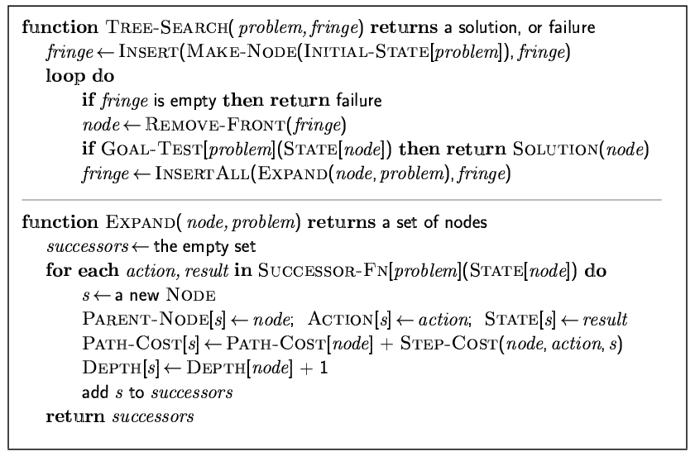
Implementation: general tree search

Slide 123
Implementation of nodes in search algorithm
A node is a bookkeeping data structure used to represent the search tree. A state corresponds to a configuration of the world. Thus, nodes are on particular paths, as defined by PARENT pointers, whereas states are not. Furthermore, two different nodes can contain the same world state if that state is generated via two different search paths.
Now that we have nodes, we need somewhere to put them. The frontier needs to be stored in such a way that the search algorithm can easily choose the next node to expand according to its preferred strategy. The appropriate data structure for this is a queue.

Slide 124
Implementation of nodes in search algorithm
The operations on a queue are as follows:
• EMPTY?(queue) returns true only if there are no more elements in the queue.
• POP(queue) removes the first element of the queue and returns it.
• INSERT(element, queue) inserts an element and returns the resulting queue.
Queues are characterized by the order in which they store the inserted nodes.
Three common variants are:
FIFO queue, which pops the oldest element of the queue;
LIFO queue (also known as a stack), which pops the newest element of the queue;
Priority queue, which pops the element of the queue with the highest priority according to some ordering function

Slide 125
Evaluating Search strategies
Performance of search strategies are evaluated along the following dimensions:-
Completeness: does it always find a solution if one exists?
Time complexity: number of nodes generated
Space complexity: maximum number of nodes in memory
Optimality: does it always find a least-cost solution?
Time and space complexities are measured in terms of
b: the branching factor or maximum number of successors of any node
d: the depth of the shallowest goal node (i.e., the number of steps along the path from the root)
m: the maximum length of any path in the state space (may be ∞)

Slide 126
Evaluating Search strategies…
Time is often measured in terms of the number of nodes generated during the search, and space in terms of the maximum number of nodes stored in memory.
For the most part, we describe time and space complexities for search on a tree; for a graph, the answer depends on how “redundant” the paths in the state space are.
To assess the effectiveness of a search algorithm, we can consider just the search cost— which typically depends on the time complexity but can also include a term for memory usage.
Or we can use the total cost, which combines the search cost and the path cost of the solution found (also sometimes called solution cost).

Slide 127
Search strategies
They are of 2 types:-
Uninformed search / Blind search
Blind search has no additional information about the states beyond that provided in the problem definition. All they can do is generate successor and distinguish a goal state from a non-goal state.
Informed search / Heuristic search
Informed search identifies whether one non-goal state is “more promising” than another one.
All search strategies are distinguished by the order in which nodes are expanded.

Slide 128
Uninformed search strategies
Uninformed search strategies use only the information available in the problem definition. Popular ones are:
Breadth-first search (BFS)
Uniform-cost search (UCS)
Depth-first search (DFS)
Depth-limited search (DLS)
Iterative deepening search (IDS)
Bidirectional search (BDS)

Slide 129
Breadth-first search
It is a strategy in which the root node is expanded first, then all the successors of the root node are expanded, then their successors. At a given depth in the search tree, all the nodes are expanded before any node at the next level is expanded.
A FIFO queue is used i.e, new successors join the tail of the queue.

Slide 130
Breadth Fast Search Algorithm

Slide 131
Breadth-first search algorithm
Create a variable NODE-LIST (FIFO queue) and set it to initial state.
Until a goal state is found or the NODE-LIST is empty,
Do
If NODE-LIST is empty then quit.
else remove the first element from NODE-LIST and call it V(visited)

Slide 132
Breadth-first search algorithm
B. For each rule ( from the rule set ) whose L.H.S matches with the state described in V
Do
Apply the rule to generate a new state.
If the new state is a goal state then quit and return the state.
Otherwise add the new state to the end of the NODE-LIST.

Slide 133
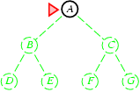
Breadth-first search
Expand shallowest unexpanded node
Implementation:
fringe is a FIFO queue, i.e., new successors go at end

Slide 134
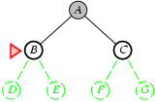
Breadth-first search
Expand shallowest unexpanded node
Implementation:
fringe is a FIFO queue, i.e., new successors go at end

Slide 135
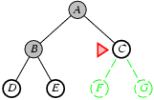
Breadth-first search
Expand shallowest unexpanded node
Implementation:
fringe is a FIFO queue, i.e., new successors go at end

Slide 136
Properties of breadth-first search
Complete? Yes (if b is finite)
Time? 1+b+b²+b³+… +b^{d} = O(b^{d})
Space? O(b^{d}) (keeps every node in memory)
Optimal? Yes ( if path cost is a non-decreasing function of depth i.e path cost = 1 per step)
Space is the bigger problem (more than time)

Slide 137
Breadth Fast Search

Slide 164
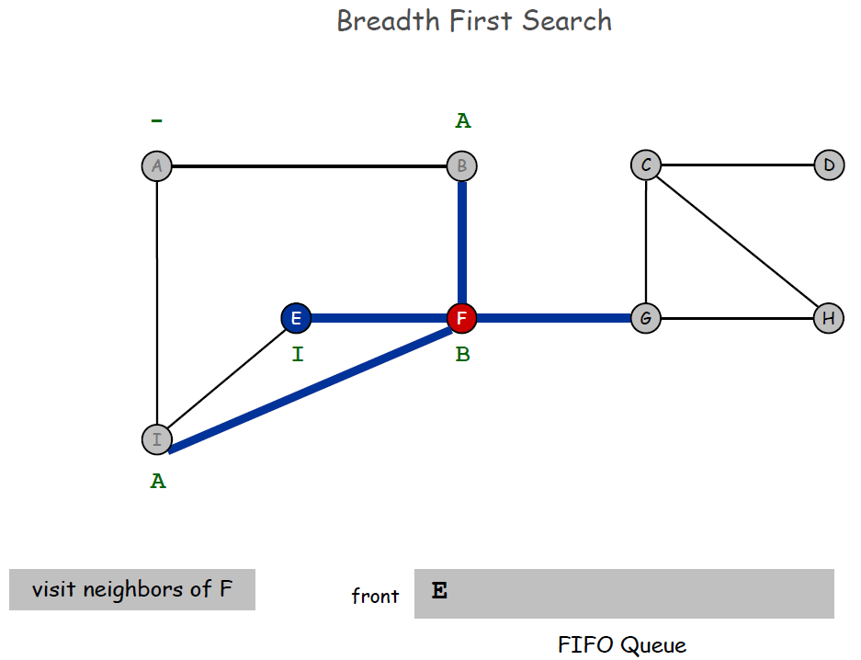

Slide 188
Uniform cost search (UCS)
When all step costs are equal, breadth-first search is optimal because it always expands the shallowest unexpanded node.
By a simple extension, we can find an algorithm that is optimal with any step-cost function. Instead of expanding the shallowest node, uniform-cost search expands the node n with the lowest path cost g(n).
This is done by storing the frontier as a priority queue ordered by g.

Slide 189
Uniform cost search (UCS)…
function UNIFORM-COST-SEARCH(problem) returns a solution, or failure
node ←a node with STATE = problem.INITIAL-STATE, PATH-COST = 0
frontier ←a priority queue ordered by PATH-COST, with node as the only element
explored ←an empty set
loop do
if EMPTY?( frontier) then return failure
node←POP( frontier ) /* chooses the lowest-cost node in frontier */
if problem.GOAL-TEST(node.STATE) then return SOLUTION(node)
add node.STATE to explored
for each action in problem.ACTIONS(node.STATE) do
child ←CHILD-NODE(problem, node, action)
if child .STATE is not in explored or frontier then
frontier ←INSERT(child , frontier )
else if child .STATE is in frontier with higher PATH-COST then
replace that frontier node with child

Slide 190
Uniform cost search (UCS)…
In addition to the ordering of the queue by path cost, there are two other significant differences from breadth-first search.
1) The first is that the goal test is applied to a node when it is selected for expansion rather than when it is first generated. The reason is that the first goal node that is generated may be on a suboptimal path.
2)The second difference is that a test is added in case a better path is found to a node currently on the frontier.
Both of these modifications come into play in the next example where the problem is to get from Sibiu to Bucharest in the Romania Touring problem.

Slide 191
Uniform cost search (UCS)…

Slide 192
Uniform cost search (UCS)…
The successors of Sibiu are Rimnicu Vilcea and Fagaras, with costs 80 and 99, respectively.
The least-cost node, Rimnicu Vilcea, is expanded next, adding Pitesti with cost 80 + 97=177.
The least-cost node is now Fagaras, so it is expanded, adding Bucharest with cost 99+211=310.
Now a goal node has been generated, but uniform-cost search keeps going, choosing Pitesti for expansion and adding a second path to Bucharest with cost 80+97+101= 278.
Now the algorithm checks to see if this new path is better than the old one; it is, so the old one is discarded. Bucharest, now with g-cost 278, is selected for expansion and the solution is returned.
It is easy to see that uniform-cost search is optimal in general. Uniform-cost search expands nodes in order of their optimal path cost. (It is because step costs are nonnegative and paths never get shorter as nodes are added.)
Hence, the first goal node selected for expansion must be the optimal solution.

Slide 193
Uniform-cost search
Expand least-cost unexpanded node
Implementation:
fringe = queue ordered by path cost
Equivalent to breadth-first if step costs all equal
Complete? Yes, if step cost ≥ ε
Time? # of nodes with g ≤ cost of optimal solution, O(b^{ceiling(C*/ ε)}) where C* is the cost of the optimal solution
Space? # of nodes with g ≤ cost of optimal solution, O(b^{ceiling(C*/ ε)})
Optimal? Yes – nodes expanded in increasing order of g(n)

Slide 194
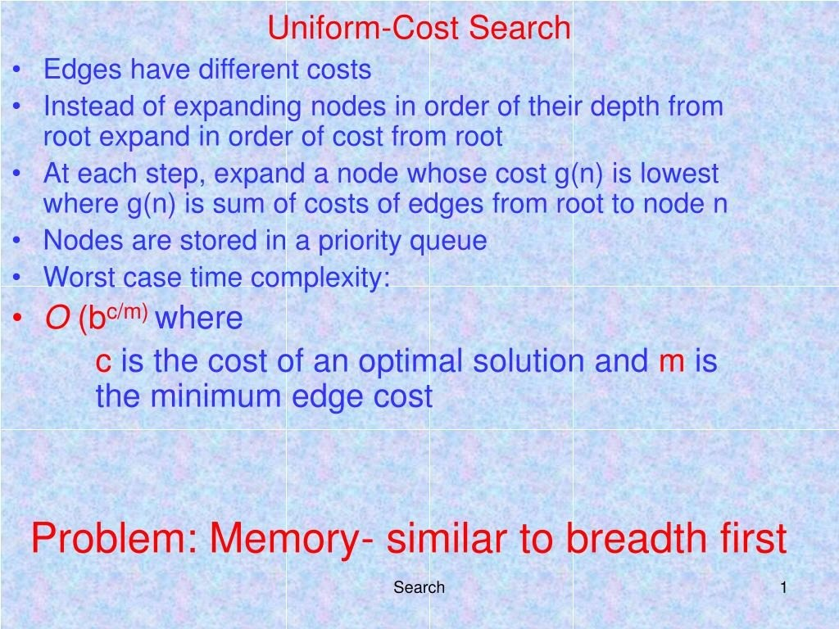

Slide 195
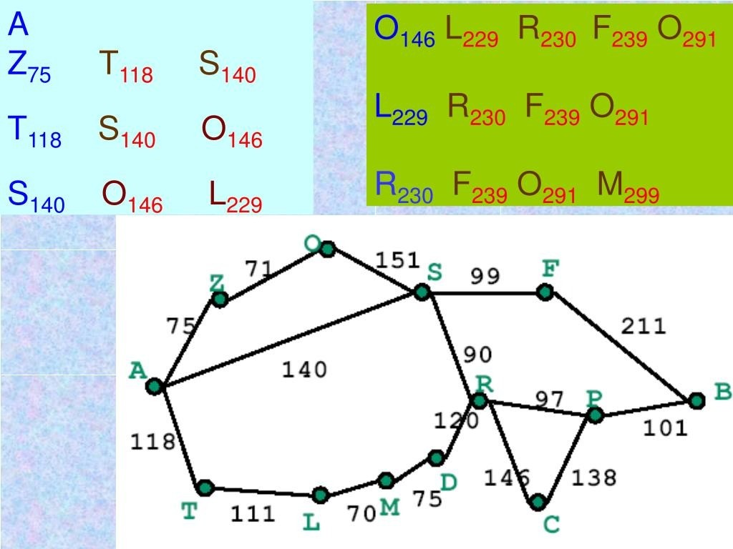

Slide 196
Depth-first search( DFS)
It is a strategy that expands the deepest node in the search tree.
Here a stack is used.

Slide 197
Depth-first search( DFS)
Form a one element stack consisting of the root node.
Until the stack is empty or the goal node is found out, repeat the following:-
Remove the first element from the stack. If it is the goal node announce success, return.
If not, add the first element’s children if any, to the top of the stack.
If the goal node is not found announce failure.

Slide 198
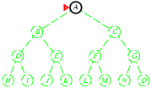
Depth-first search
Expand deepest unexpanded node
Implementation:
fringe = LIFO queue, i.e., put successors at front

Slide 199
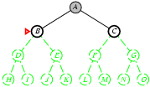
Depth-first search
Expand deepest unexpanded node
Implementation:
fringe = LIFO queue, i.e., put successors at front

Slide 200
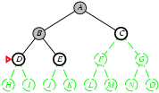
Depth-first search
Expand deepest unexpanded node
Implementation:
fringe = LIFO queue, i.e., put successors at fron

Slide 201
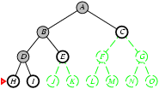
Depth-first search
Expand deepest unexpanded node
Implementation:
fringe = LIFO queue, i.e., put successors at front

Slide 202
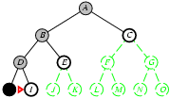
Depth-first search
Expand deepest unexpanded node
Implementation:
fringe = LIFO queue, i.e., put successors at front

Slide 203
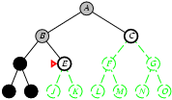
Depth-first search
Expand deepest unexpanded node
Implementation:
fringe = LIFO queue, i.e., put successors at front

Slide 204
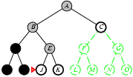
Depth-first search
Expand deepest unexpanded node
Implementation:
fringe = LIFO queue, i.e., put successors at front

Slide 205
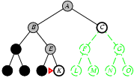
Depth-first search
Expand deepest unexpanded node
Implementation:
fringe = LIFO queue, i.e., put successors at front

Slide 206
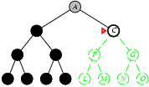
Depth-first search
Expand deepest unexpanded node
Implementation:
fringe = LIFO queue, i.e., put successors at front

Slide 207
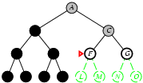
Depth-first search
Expand deepest unexpanded node
Implementation:
fringe = LIFO queue, i.e., put successors at front

Slide 208
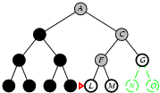
Depth-first search
Expand deepest unexpanded node
Implementation:
fringe = LIFO queue, i.e., put successors at front

Slide 209
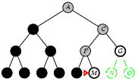
Depth-first search
Expand deepest unexpanded node
Implementation:
fringe = LIFO queue, i.e., put successors at front

Slide 210
Properties of depth-first search
Complete? No: fails in infinite-depth spaces, spaces with loops
We may modify the algorithm to avoid repeated states along the path DFS is complete in finite spaces.
Time? The number of nodes generated is of the order of O(b^{m}) . It is terrible if m is much larger than d
but if solutions are dense, may be much faster than breadth-first
Space? It only stores the unexpanded nodes. So it requires 1 +b + b +b ….. m times = O(bm), i.e., linear space!
Optimal? No. If it makes a wrong choice, it may go down a very long path and finds a solution, where as there may be a better solution at a higher level in the tree.

Slide 211
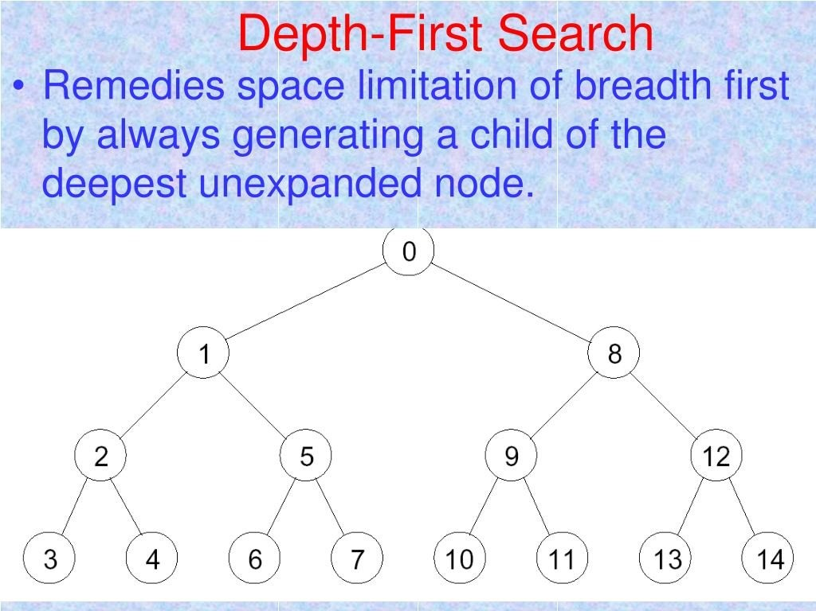

Slide 212
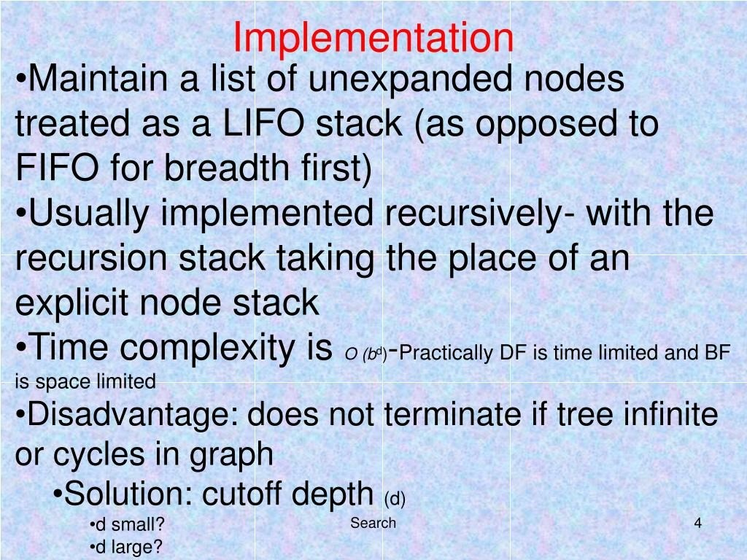

Slide 213
DFS Algorithm
DFS will continue to visit neighbors in a recursive pattern
Whenever we visit v from u, we recursively visit all unvisited neighbors of v. Then we backtrack (return) to u.
Note: it is possible that w2 was unvisited when we recursively visit w1, but became visited by the time we return from the recursive call.
u
v
w3
w1
w2

Slide 214
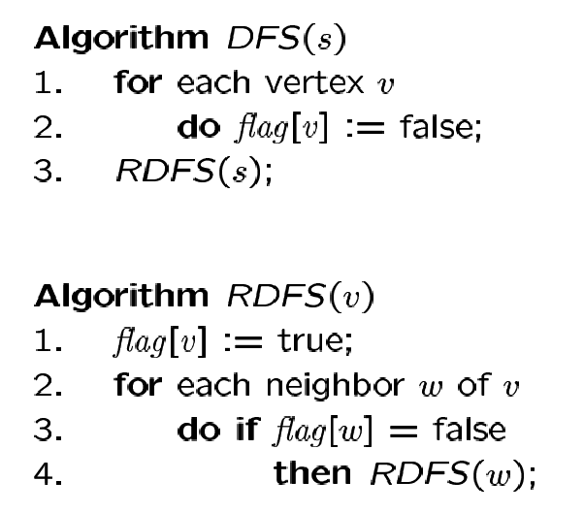
DFS Algorithm
Flag all vertices as not visited
Flag yourself as visited
For unvisited neighbors, call RDFS(w) recursively
We can also record the paths using pred[ ].

Slide 215
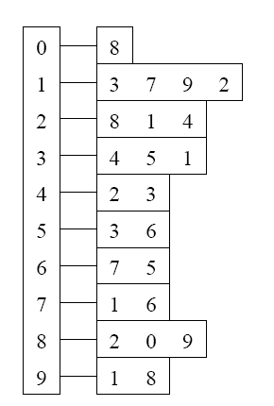
Example
Adjacency List
Visited Table (T/F)
0
0
1
2
3
4
5
6
7
8
9
F
F
F
F
F
F
F
F
F
F
-
-
-
-
-
-
-
-
-
-
8
source
2
9
1
3
7
6
4
5
Pred
Initialize visited
table (all False)
Initialize Pred to -1

Slide 216
Example
Adjacency List
Visited Table (T/F)
0
0
1
2
3
4
5
6
7
8
9
F
F
T
F
F
F
F
F
F
F
-
-
-
-
-
-
-
-
-
-
8
source
2
9
1
3
7
6
4
5
Pred
Mark 2 as visited
RDFS( 2 )
Now visit RDFS(8)

Slide 217
Example
Adjacency List
Visited Table (T/F)
0
8
0
1
2
3
4
5
6
7
8
9
F
F
T
F
F
F
F
F
T
F
-
-
-
-
-
-
-
-
2
-
source
2
9
1
3
7
6
4
5
Pred
Mark 8 as visited
mark Pred[8]
Recursive calls
RDFS( 2 )
RDFS(8)
2 is already visited, so visit RDFS(0)

Slide 218
Example
Adjacency List
Visited Table (T/F)
0
8
0
1
2
3
4
5
6
7
8
9
T
F
T
F
F
F
F
F
T
F
8
-
-
-
-
-
-
-
2
-
source
2
9
1
3
7
6
4
5
Pred
Mark 0 as visited
Mark Pred[0]
Recursive calls
RDFS( 2 )
RDFS(8)
RDFS(0) -> no unvisited neighbors, return
to call RDFS(8)

Slide 219
Example
Back to 8
Adjacency List
Visited Table (T/F)
0
8
0
1
2
3
4
5
6
7
8
9
T
F
T
F
F
F
F
F
T
F
8
-
-
-
-
-
-
-
2
-
source
2
9
1
3
7
6
4
5
Pred
Recursive calls
RDFS( 2 )
RDFS(8)
Now visit 9 -> RDFS(9)

Slide 220
Example
Adjacency List
Visited Table (T/F)
0
8
0
1
2
3
4
5
6
7
8
9
T
F
T
F
F
F
F
F
T
T
8
-
-
-
-
-
-
-
2
8
source
2
9
1
3
7
6
4
5
Pred
Mark 9 as visited
Mark Pred[9]
Recursive calls
RDFS( 2 )
RDFS(8)
RDFS(9)
-> visit 1, RDFS(1)

Slide 221
Example
Adjacency List
Visited Table (T/F)
0
8
0
1
2
3
4
5
6
7
8
9
T
T
T
F
F
F
F
F
T
T
8
9
-
-
-
-
-
-
2
8
source
2
9
1
3
7
6
4
5
Pred
Mark 1 as visited
Mark Pred[1]
Recursive calls
RDFS( 2 )
RDFS(8)
RDFS(9)
RDFS(1)
visit RDFS(3)

Slide 222
Example
Adjacency List
Visited Table (T/F)
0
8
0
1
2
3
4
5
6
7
8
9
T
T
T
T
F
F
F
F
T
T
8
9
-
1
-
-
-
-
2
8
source
2
9
1
3
7
6
4
5
Pred
Mark 3 as visited
Mark Pred[3]
Recursive calls
RDFS( 2 )
RDFS(8)
RDFS(9)
RDFS(1)
RDFS(3)
visit RDFS(4)

Slide 223
Example
Adjacency List
Visited Table (T/F)
0
8
0
1
2
3
4
5
6
7
8
9
T
T
T
T
T
F
F
F
T
T
8
9
-
1
3
-
-
-
2
8
source
2
9
1
3
7
6
4
5
Pred
RDFS( 2 )
RDFS(8)
RDFS(9)
RDFS(1)
RDFS(3)
RDFS(4) → STOP all of 4’s neighbors have been visited
return back to call RDFS(3)
Mark 4 as visited
Mark Pred[4]
Recursive calls

Slide 224
Example
Adjacency List
Visited Table (T/F)
0
8
0
1
2
3
4
5
6
7
8
9
T
T
T
T
T
F
F
F
T
T
8
9
-
1
3
-
-
-
2
8
source
2
9
1
3
7
6
4
5
Back to 3
Pred
RDFS( 2 )
RDFS(8)
RDFS(9)
RDFS(1)
RDFS(3)
visit 5 -> RDFS(5)
Recursive calls

Slide 225
Example
Adjacency List
Visited Table (T/F)
0
8
0
1
2
3
4
5
6
7
8
9
T
T
T
T
T
T
F
F
T
T
8
9
-
1
3
3
-
-
2
8
source
2
9
1
3
7
6
4
5
Pred
RDFS( 2 )
RDFS(8)
RDFS(9)
RDFS(1)
RDFS(3)
RDFS(5)
3 is already visited, so visit 6 -> RDFS(6)
Recursive calls
Mark 5 as visited
Mark Pred[5]

Slide 226
Example
Adjacency List
Visited Table (T/F)
0
8
0
1
2
3
4
5
6
7
8
9
T
T
T
T
T
T
T
F
T
T
8
9
-
1
3
3
5
-
2
8
source
2
9
1
3
7
6
4
5
RDFS( 2 )
RDFS(8)
RDFS(9)
RDFS(1)
RDFS(3)
RDFS(5)
RDFS(6)
visit 7 -> RDFS(7)
Pred
Recursive calls
Mark 6 as visited
Mark Pred[6]

Slide 227
Example
Adjacency List
Visited Table (T/F)
0
8
0
1
2
3
4
5
6
7
8
9
T
T
T
T
T
T
T
T
T
T
8
9
-
1
3
3
5
6
2
8
source
2
9
1
3
7
6
4
5
Pred
RDFS( 2 )
RDFS(8)
RDFS(9)
RDFS(1)
RDFS(3)
RDFS(5)
RDFS(6)
RDFS(7) -> Stop no more unvisited neighbors
Recursive calls
Mark 7 as visited
Mark Pred[7]

Slide 228
Example
Adjacency List
Visited Table (T/F)
0
0
1
2
3
4
5
6
7
8
9
T
T
T
T
T
T
T
T
T
T
8
9
-
1
3
3
5
6
2
8
8
source
2
9
1
3
7
6
4
5
RDFS( 2 )
RDFS(8)
RDFS(9)
RDFS(1)
RDFS(3)
RDFS(5)
RDFS(6) -> Stop
Pred
Recursive calls

Slide 229
Example
Adjacency List
Visited Table (T/F)
0
0
1
2
3
4
5
6
7
8
9
T
T
T
T
T
T
T
T
T
T
8
9
-
1
3
3
5
6
2
8
8
source
2
9
1
3
7
6
4
5
RDFS( 2 )
RDFS(8)
RDFS(9)
RDFS(1)
RDFS(3)
RDFS(5) -> Stop
Pred
Recursive calls

Slide 230
Example
Adjacency List
Visited Table (T/F)
0
0
1
2
3
4
5
6
7
8
9
T
T
T
T
T
T
T
T
T
T
8
9
-
1
3
3
5
6
2
8
8
source
2
9
1
3
7
6
4
5
RDFS( 2 )
RDFS(8)
RDFS(9)
RDFS(1)
RDFS(3) -> Stop
Pred
Recursive calls

Slide 231
Example
Adjacency List
Visited Table (T/F)
0
0
1
2
3
4
5
6
7
8
9
T
T
T
T
T
T
T
T
T
T
8
9
-
1
3
3
5
6
2
8
8
source
2
9
1
3
7
6
4
5
RDFS( 2 )
RDFS(8)
RDFS(9)
RDFS(1) -> Stop
Pred
Recursive calls

Slide 232
Example
Adjacency List
Visited Table (T/F)
0
0
1
2
3
4
5
6
7
8
9
T
T
T
T
T
T
T
T
T
T
8
9
-
1
3
3
5
6
2
8
8
source
2
9
1
3
7
6
4
5
RDFS( 2 )
RDFS(8)
RDFS(9) -> Stop
Pred
Recursive calls

Slide 233
Example
Adjacency List
Visited Table (T/F)
0
0
1
2
3
4
5
6
7
8
9
T
T
T
T
T
T
T
T
T
T
8
9
-
1
3
3
5
6
2
8
8
source
2
9
1
3
7
6
4
5
RDFS( 2 )
RDFS(8) -> Stop
Pred
Recursive calls

Slide 234
Example
Adjacency List
Visited Table (T/F)
0
0
1
2
3
4
5
6
7
8
9
T
T
T
T
T
T
T
T
T
T
8
9
-
1
3
3
5
6
2
8
8
source
2
9
1
3
7
6
4
5
RDFS( 2 ) -> Stop
Pred
Recursive calls

Slide 235
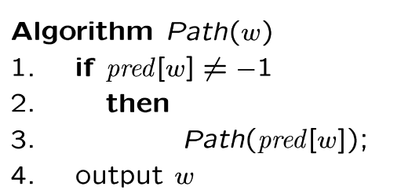
Example
0
Adjacency List
Visited Table (T/F)
8
0
1
2
3
4
5
6
7
8
9
T
T
T
T
T
T
T
T
T
T
8
9
-
1
3
3
5
6
2
8
source
2
9
1
3
7
6
4
5
Check our paths, does DFS find valid paths? Yes.
Pred
Try some examples.
Path(0) ->
Path(6) ->
Path(7) ->

Slide 236
Depth-limited search
The problem with DFS is that the search can go down an infinite branch and thus never return. Depth limited search avoids this problem by imposing a depth limit l which effectively terminates the search at that depth. That is , nodes at depth l are treated as if they have no successors.
The choice of depth parameter l is an important factor. If l is too deep , it is wasteful in terms of both time and space. But if l < d (the depth at which solution exists) i,e the shallowest goal is beyond the depth limit, then this algorithm will never reach a goal state.

Slide 237
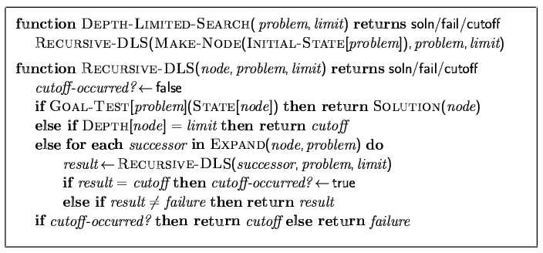
Depth-limited search
Depth-first search with depth limit l,
i.e., nodes at depth l have no successors Recursive implementation:

Slide 238
Properties of depth- limited search
Complete? If l >= d , then it is.
Time? O(b ^{l} ).
Space? O(bl), i.e., linear space.
Optimal? No.

Slide 239
Iterative deepening search
The problem with depth-limited search is deciding on a suitable depth parameter, which is not always easy.
To overcome this problem there is another search called iterative deepening search. This search method simply tries all possible depth limits; first 0, then 1, then 2 etc. until a solution is found. Iterative deepening combines the benefits of DFS and BFS. It may appear wasteful as it is expanding nodes multiple times. But the overhead is small in comparison to the growth of an exponential search tree.

Slide 240
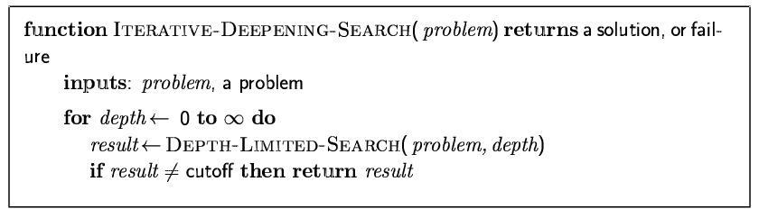
Iterative deepening search

Slide 241
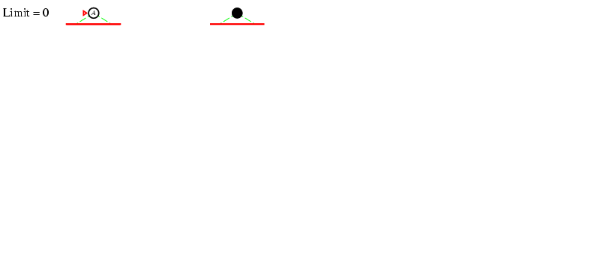
Iterative deepening search l =0

Slide 242
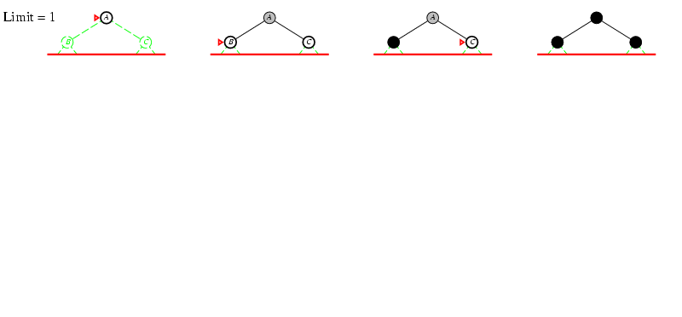
Iterative deepening search l =1

Slide 243
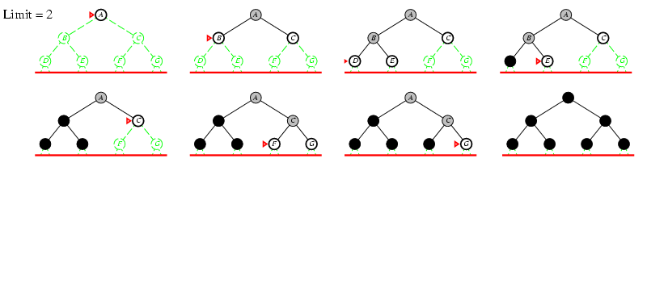
Iterative deepening search l =2

Slide 244

Iterative deepening search l =3

Slide 245
Iterative deepening search
Number of nodes generated in a breadth first search to depth d with branching factor b:
N_{BFS} = b⁰ + b¹ + b² + … + b^{d-2} + b^{d-1} + b^{d}
Number of nodes generated in an iterative deepening search to depth d with branching factor b:
N_{IDS} = (d+1)b⁰ + d b^¹ + (d-1)b^² + … + 3b^{d-2} +2b^{d-1} + 1b^{d}
as the nodes at the bottom level d are expanded once, the nodes at (d-1) are expanded twice, those at (d – 3) are expanded three times and so on back to the root.

Slide 246
Iterative deepening search
For b = 10, d = 5,
N_{BFS} = 1 + 10 + 100 + 1,000 + 10,000 + 100,000 = 111,111
N_{IDS} = 6 + 50 + 400 + 3,000 + 20,000 + 100,000 = 123,456
Overhead = (123,456 - 111,111)/111,111 = 11%
we can see that compared to the overall number of expansions , the total is not substantially increased.

Slide 247
Properties of iterative deepening search
Complete? Yes , like BFS it is complete when b is finite.
Time? (d+1)b⁰ + d b¹ + (d-1)b² + … + b^{d} = O(b^{d})
Space? O(bd) , like DFS memory requirement is linear.
Optimal? Yes, if like BFS path cost is a non-decreasing function of the depth of the node, it is optimal.
In general iterative deepening is the preferred uninformed search method when there is a large search space and the depth of the solution is not known.

Slide 248


Slide 249


Slide 250


Slide 251


Slide 252

Summary of algorithms

Slide 253
Bidirectional Search (BDS)

Slide 254
BDS (contd…)
The time complexity of bidirectional search using breadth-first searches in both directions is O(b^{d/2}). The space complexity is also O(b^{d/2}). This is because search stops in the midway as soon as any one of the search paths from initial state (forward search) meets with any one of the search paths from goal state (backward search).
For the similar condition, the time complexity of breadth first search from initial state to goal state is O(b^{d}). The space complexity is also O(b^{d}). It is because searching proceeds only in one direction i.e. from initial state to goal state (only forward search).
The motivation is that b^{d/2} + b^{d/2} is much less than b^{d}, or in the figure, the area of the two small circles is less than the area of one big circle centered on the start and reaching to the goal.

Slide 255


Slide 256


Slide 257


Slide 258


Slide 259
Comparing Uninformed Search Strategies

Slide 260

Repeated states
Failure to detect repeated states can turn a linear problem into an exponential one!

Slide 261
Repeated states
In most searching algorithm, the state space generates an exponentially larger search tree. This occurs mainly because of repeated nodes. If we can avoid the generation of repeated nodes we can limit the number of nodes that are created and stop the expansion of repeated nodes.

Slide 262
Repeated states
There are three methods having increasing order of computational overhead to control the generation of repeated nodes:-

Slide 263
Repeated states
Don’t generate a node that is the same as the parent node.
Don’t create paths with cycles in them. To do this we can check each ancestor node and refuse to create a state that is the same as this set of nodes.
Don’t generate any state that is the same as any state generated before. This requires that every state is kept in memory. (space complexity is O(b^{d} ) )

Slide 264

Graph search

Slide 265
Summary
Problem formulation usually requires abstracting away real-world details to define a state space that can feasibly be explored
Variety of uninformed search strategies
Iterative deepening search uses only linear space and not much more time than other uninformed algorithms

Slide 266
Informed Search Strategy

Slide 267
Informed Search Strategy (Best-first search)

Slide 268
Heuristic search techniques
Blind searches (uninformed searches)are normally very inefficient. By adding domain knowledge we can improve the search process.
The idea behind the heuristic search is that we explore the node that is most likely to be nearest to a goal state.
A heuristic function has some knowledge about the problem so that it can judge how close the current state is to the goal state.
A heuristic function h(n) = estimated cost of the cheapest path from the state at node n to a goal state.

Slide 269
Informed Search Strategy (Heuristic functions)
The choice of f determines the search strategies.
Most best first algorithms include as a component of f a heuristic function, denoted h(n)
h(n) = estimated cost of the cheapest path from the state at node n to a goal state.
h(n) takes a node as input, unlike g(n) in UCS, it depends only on the state at that node.
For example, in Romania, one might estimate the cost of the cheapest path from Arad to Bucharest via the straight-line distance from Arad to Bucharest.

Slide 270
Heuristic functions (contd…)
Heuristic functions are the most common form in which additional knowledge of the problem is imparted to search algorithm.
For the present context, we consider these heuristic function to be arbitrary, nonnegative, problem-specific functions, with one constraint :
If n is a goal state, then h(n) = 0.

Slide 271


Slide 272


Slide 273


Slide 274


Slide 275
Best-first search
Idea: use an evaluation function f(n) for each node
Use this to estimate the degree of "desirability“ for each node.
Then expand the most desirable unexpanded node.
Implementation:
Order the nodes in fringe or sequence in decreasing order of desirability.
Two special cases of Best-first search where h(n) is used as f(n) to guide search:
Greedy best-first search [only h(n) is used as f(n)]
A* search [h(n) + g(n) is used as f(n)]

Slide 276
Greedy best-first search
It tries to expand the node that is closest to the goal state.
It follows a single path but switch over to a different path if it appears to be more promising at any stage.
A promising node is selected by applying a suitable HF [Heuristic Function, h(n)]to each competing node.

Slide 277
Data structures used for best-first search
OPEN
It is a priority queue of nodes which have been generated and have had the heuristic function applied to them but which have not yet been expanded. ( priority is evaluated by a HF value).
CLOSED
It contains nodes that have already been expanded. ( it is used to ensure that the same node is not expanded more than once.)

Slide 278
Greedy best-first search
Evaluation function f(n) = h(n) (heuristic)
= estimate of cost from n to goal
e.g., h_{SLD}(n) = straight-line distance from n to Bucharest
Greedy best-first search expands the node that appears to be closest to goal

Slide 279

Romania Example: with step costs [in Kms] and $h_{SLD}\left(n\right) [in Kms]$

Slide 280
Greedy best-first search algorithm
Start with OPEN containing just the initial state.
Until a goal is found or there are no nodes left on OPEN do:
Pick the best node from OPEN.
Generate its successors.

Slide 281
Greedy best-first search algorithm (contd…)
c) For each successor do:
i) If it has not been generated before , evaluate it, add it to OPEN, and record its parent.
ii) If it has been generated before, change the parent if this new path is better than the previous one. In that case , update the cost of getting to this node and to any successors that this node may already have.

Slide 282


Slide 283


Slide 284


Slide 285


Slide 286


Slide 287


Slide 288


Slide 289

Greedy best-first search example: (Romania example)

Slide 290

Greedy best-first search example (contd…)

Slide 291

Greedy best-first search example (contd…)

Slide 292

Greedy best-first search example (contd…)

Slide 293
Properties of Greedy best-first search
Complete? No – can get stuck in loops, e.g., Iasi → Neamt → Iasi → Neamt →….
Time? O(b^{m}), but a good heuristic can give dramatic improvement
Space? O(b^{m}) -- keeps all nodes in memory
Optimal? No

Slide 294
Properties of Greedy best-first search (contd…)

Slide 295
A* search
Idea: avoid expanding paths that are already expensive
Evaluation function f(n) = g(n) + h(n)
g(n) = cost so far to reach n
h(n) = estimated cost from n to goal
f(n) = estimated total cost of path through n to goal

Slide 296
A* search
The Best first search algorithm is a simplified version of A* algorithm .
A* uses the same f, g ,h functions as well as the lists OPEN and CLOSED.
A* algorithm:-
start with OPEN containing only the initial node. Set that node’s g value to zero , its h value to whatever it is and its f value to h + 0 = h. initially closed is empty.

Slide 297
A* search
2. Until a goal node is found, repeat the procedure:
if there are no nodes on OPEN, report failure. Otherwise, pick the node from OPEN with the lowest f value. Call it BESTNODE. Remove it from OPEN , place it on CLOSED . If BESTNODE is a goal node, then exit and report a solution; else generate the successors of BESTNODE. For each such successor, do the following:

Slide 298
A* search
Set SUCCESSOR to point back to BESTNODE.
Compute g(SUCCESSOR) = g( BESTNODE) + the cost of getting from BESTNODE to SUCCESSOR.
See if SUCCESSOR is the same as any node on OPEN. If so, call that node OLD. Since this node already exists in the graph, we can throw SUCCESSOR away and add OLD to the list of BESTNODES successors.

Slide 299
A* search
determine the parent link:- If the path just found to SUCCESSOR is cheaper than the current best path to OLD, then reset OLD’s parent – link to BESTNODE; else, don’t update anything.
d) if SUCCESSOR is not in OPEN but in CLOSED, call it OLD and add OLD to the list of BESTNODE’s successors. Check to see if the new path is better as in step (c) . If it is, then set the parent link and g and f value appropriately. Propagate the new cost downward and determine the better path. If required set the parent link accordingly.

Slide 300
A* search
e) If SUCCESSOR is neither in OPEN nor in CLOSED , then put it on OPEN and add it to the list of BESTNODE’s successors. Compute f(SUCCESSOR) = g(SUCCESSOR) + h( SUCCESSOR)

Slide 301

A* search example

Slide 302

A* search example(Romania example)

Slide 303

A* search example

Slide 304

A* search example

Slide 305

A* search example

Slide 306

A* search example

Slide 307
Properties of A*
Complete? Yes (unless there are infinitely many nodes with f ≤ f(G) )
Time? Exponential
Space? Keeps all nodes in memory
Optimal? Yes if h(n) is admissible.

Slide 308
Admissible heuristics
A heuristic h(n) is admissible if for every node n,
h(n) ≤ h*(n), where h*(n) is the true cost to reach the goal state from n.
An admissible heuristic never overestimates the cost to reach the goal, i.e., it is optimistic
Example: h_{SLD}(n) (never overestimates the actual road distance)
Theorem: If h(n) is admissible, A* using TREE-SEARCH is optimal

Slide 309

Consistent heuristics
A heuristic is consistent if for every node n, every successor n' of n generated by any action a, h(n) ≤ c(n,a,n') + h(n')
If h is consistent, we have
f(n') = g(n') + h(n')
= g(n) + c(n,a,n') + h(n')
≥ g(n) + h(n)
= f(n)
i.e., f(n) is non-decreasing along any path.
Theorem: If h(n) is consistent, A* using GRAPH-SEARCH is optimal

Slide 310
Some Example Search Graphs

Slide 311
Some Example Search Graphs (contd…)
In this problem the start state is S, and the goal state is G. The transition costs are next to the edges, and the heuristic estimate, h, of the distance from the state to the goal is in the state’s node. Assume ties are always broken by choosing the state which comes first alphabetically.
1. What is the order of states expanded using Depth First Search? Assume DFS terminates as soon as it reaches the goal state.
Answer: S, A, B, D, F ,G
2. What is the order of states expanded using Breadth First Search?
Answer: S, A, B, C, D, E, F, G
3. What is the order of states expanded using Best First Search? Assume BFS terminates as soon as it reaches the
goal state.
Answer: S, B, D, F, G
4. What is the order of states expanded using A* search?
Answer: S, A, B, D, C, E, F, G
5. What is a least cost path from S to G?
Answer: S, A, C, F, G

Slide 312
Admissible heuristics
E.g., for the 8-puzzle:
h₁(n) = number of misplaced tiles
h₂(n) = total Manhattan distance
(i.e., no. of squares from desired location of each tile)
h₁(S) = ?
h₂(S) = ?

Slide 313
Admissible heuristics
E.g., for the 8-puzzle:
h₁(n) = number of misplaced tiles
h₂(n) = total Manhattan distance
(i.e., no. of squares from desired location of each tile)
h₁(S) = ? 8
h₂(S) = ? 3+1+2+2+2+3+3+2 = 18

Slide 314
8-puzzle heuristics: explanation

Slide 315
8-puzzle heuristics: explanation (contd…)

Slide 316
Beyond Classical Search
Chapter-4

Slide 317
Local Search Algorithms and Optimization Problems
Systematic Search problems:
The search algorithms that we have seen so far are designed to explore search spaces systematically. This systematicity is achieved by keeping one or more paths in memory and by recording which alternatives have been explored at each point along the path. When a goal is found, the path to that goal also constitutes a solution to the problem (a sequence of actions from initial state to goal state).
Local Search problems:
These algorithms perform purely local search in the state space, evaluating and modifying one or more current states rather than systematically exploring paths from an initial state. These algorithms are suitable for problems in which all that matters is the solution state, not the path cost to reach it. The path to the goal is irrelevant.
For example, in the 8-queens problem what matters is the final configuration of queens, not the order in which they are added.

Slide 318
Local Search Algorithms and Optimization Problems (contd…)
The same general property holds for many important applications as indicated below:
Integrated-circuit design
Factory-floor layout
Job-shop scheduling
Automatic programming
Telecommunications network optimization
Vehicle routing
Portfolio management
The family of local search algorithms includes: Hill Climbing, Simulated Annealing (inspired by statistical physics), Local Beam search and Genetic Algorithms (inspired by evolutionary biology).

Slide 319
Local Search Algorithms and Optimization Problems (contd…)
If the path to the goal does not matter, we might consider a different class of algorithms, ones that do not worry about paths at all.
Local search algorithms operate using a single current node (rather than multiple paths) and generally move only to neighbors of that node. Typically, the paths followed by the search are not retained. Although local search algorithms are not systematic, they have two key advantages:
(1) they use very little memory—usually a constant amount;
(2) they can often find reasonable solutions in large or infinite (continuous) state spaces for which systematic algorithms are unsuitable.

Slide 320
Local Search Algorithms and Optimization Problems (contd…)
In addition to finding goals, local search algorithms are useful for solving pure optimization problems, in which the aim is to find the best state according to an objective function.
Many optimization problems do not fit the “standard” search model (both uninformed and informed).
For example, nature provides an objective function—reproductive fitness—that Darwinian evolution could be seen as attempting to optimize, but there is no “goal test” and no “path cost” for this problem.

Slide 321
Local Search Algorithms and Optimization Problems (contd…)
To understand local search, we find it useful to consider the state-space landscape. A landscape has both “location” (defined by the state) and “elevation” (defined by the value of the heuristic cost function or objective function).
If elevation corresponds to cost, then the aim is to find the lowest valley—a global minimum;
if elevation corresponds to an objective function, then the aim is to find the highest peak—a global maximum.
We can convert from one to the other just by inserting a minus sign.
Local search algorithms explore this landscape. A complete local search algorithm always finds a goal if one exists; an optimal algorithm always finds a global minimum/maximum.

Slide 322
Local Search Algorithms and Optimization Problems (contd…)

Slide 323
Hill climbing
Hill climbing ( basic or steepest-ascent) search algorithm is a local search algorithm.
It is often used when a good heuristic function is available for evaluating states but when no other useful knowledge is available. This algorithm is simply a loop that continuously moves in the direction of increasing value i.e uphill. It terminates when it reaches a “peak” where no neighbor has a higher value. The algorithm doesn’t maintain a search tree, so the current node data structure only records the state and its objective function value. Hill – climbing doesn’t look ahead beyond the immediate neighbors of the current state.
This resembles trying to find the top of Mount Everest in a thick fog while suffering from amnesia.

Slide 324
Basic Hill climbing algorithm
Evaluate the initial state (IS). If it is the goal state (GS) , then return it and quit. Else consider IS as the current state (CS) and proceed.
Loop until a solution is found or there are no new operator (OP) to be applied to the CS.
Select an OP that has not yet been applied to the CS and apply it to produce a new state (NS).

Slide 325
Basic Hill climbing algorithm (contd…)
b) Evaluate the NS:
If NS is a GS , then return it and quit.
If it is not a GS but better than the CS, then consider it as the current state(i,e CS NS) and proceed.
If NS is not better than CS then continue in the loop by selecting the next appropriate OP for CS.

Slide 326
Steepest-ascent Hill climbing algorithm
It considers all the moves from the CS and selects the best one as the next state. It is also called gradient search.
Algorithm
Evaluate the initial state (IS). If it is the goal state (GS) , then return it and quit. Else consider IS as the current state (CS) and proceed.
Loop until a solution is found or until a complete iteration produces no change to the CS:

Slide 327
Steepest-ascent Hill climbing algorithm (contd…)
Let successor (SUCC) be a state such that any NS that can be generated from CS is better than SUCC. [ i.e setting SUCC to a minimum value at the beginning of an iteration or set CS as SUCC]
For each operator OP that applies to the CS do:
Apply OP to CS and generate a NS.
Evaluate the NS. If it is a GS then return it and quit. If not , compare it with SUCC. If NS is better than SUCC, then set SUCC to NS; else leave SUCC unchanged.
If the SUCC is better than CS, then set CS to SUCC [i.e move to the next best state]

Slide 328

Hill-climbing search
"Like climbing Everest in thick fog with amnesia"

Slide 329
Hill-climbing search
Both basic and steepest-ascent hill climbing may fail to find a solution. Either algorithm may terminate not by finding a goal state but by getting to a state from which no better states can be generated.
This will happen if the program has reached either a local maximum or a plateau or a ridge.

Slide 330
Hill-climbing search
A local maximum is a state that is better than all its neighbors but is not better than some other states farther away.
Solution of local maxima:-
Move in some arbitrary direction
Back track to an ancestor and try some other alternatives.
A plateau is a flat area in the search space in which all the neighboring states have the same heuristic function value. It can be a flat local maximum, from which no uphill exit exists, or a shoulder, from which progress is possible. A hill-climbing search might get lost on the plateau.
Solution of plateau
Expand few generation ahead to move to a different section of the search space.

Slide 331
Hill-climbing search
A ridge is an area in the search space which is higher than its surroundings but itself has slopes. It is not possible to traverse a ridge by a single move i. e. no such operator is available.
Solution of ridges:-
Apply several operators before doing the evaluation

Slide 332
Hill-climbing search (via ridge)

Slide 333

Hill-climbing search
Problem: depending on initial state, can get stuck in local maxima

Slide 334

Hill-climbing search: 8-queens problem
h = number of pairs of queens that are attacking each other, either directly or indirectly
h = 17 for the above state The best moves (or successors) having h = 12 are marked

Slide 335

Hill-climbing search: 8-queens problem
A local minimum with h = 1

Slide 336
Hill-climbing search: 8-queens problem
A local minimum with h = 0

Slide 337
Variants of Hill Climbing
1. Stochastic hill climbing: It chooses at random from among the uphill moves; the probability of selection can vary with the steepness of the uphill move. This usually converges more slowly than steepest ascent, but in some state landscapes, it finds better solutions.
2. First-choice hill climbing: It implements stochastic hill climbing by generating successors randomly until one is generated that is better than the current state. This is a good strategy when a state has many (e.g., thousands) of successors.
(The hill-climbing algorithms described so far are incomplete—they often fail to find a goal when one exists because they can get stuck on local maxima.)
3. Random-restart hill climbing adopts the well-known adage, “If at first you don’t succeed, try, try again.” It conducts a series of hill-climbing searches from randomly generated initial states, until a goal is found.
(The success of hill climbing depends very much on the shape of the state-space landscape: if there are few local maxima and plateaus, random-restart hill climbing will find a good solution very quickly.)

Slide 338
Simulated Annealing
A hill-climbing algorithm that never makes “downhill” moves toward states with lower value (or higher cost) is guaranteed to be incomplete, because it can get stuck on a local maximum.
In contrast, a purely random walk—that is, moving to a successor chosen uniformly at random from the set of successors—is complete but extremely inefficient.
Therefore, it seems reasonable to try to combine hill climbing with a random walk in some way that yields both efficiency and completeness.
Simulated annealing is such an algorithm.
Simulated annealing was first used extensively to solve VLSI layout problems in the early 1980s. It has been applied widely to factory scheduling and other large-scale optimization tasks.

Slide 339
Simulated Annealing (contd…)
In metallurgy, annealing is the process used to temper or harden metals and glass by heating them to a high temperature and then gradually cooling them, thus allowing the material to reach a low energy crystalline state.
To explain simulated annealing, we switch our point of view from hill climbing to gradient descent (i.e., minimizing cost) and imagine the task of getting a ping-pong ball into the deepest crevice in a bumpy surface.
If we just let the ball roll, it will come to rest at a local minimum. If we shake the surface, we can bounce the ball out of the local minimum. The trick is to shake just hard enough to bounce the ball out of local minima but not hard enough to dislodge it from the global minimum.
The simulated-annealing solution is to start by shaking hard (i.e., at a high temperature) and then gradually reduce the intensity of the shaking (i.e., lower the temperature).

Slide 340

Simulated Annealing Algorithm
function SIMULATED-ANNEALING(problem, schedule) returns a solution state
inputs: problem, a problem
schedule , a mapping from time to “temperature”
current ← MAKE-NODE (problem.INITIAL-STATE)
for t = 1 to ∞ do
T ← schedule (t)
if T = 0 then return current
Next ← a randomly selected successor of current
ΔE ← next.VALUE – current.VALUE
if ΔE >0 then current ← next
else current ← next only with probability $e^{\text{Δ}\text{E}\text{/}\text{T} }$

Slide 341

Simulated Annealing Algorithm (contd…)
function SIMULATED-ANNEALING(problem, schedule) returns a solution state
inputs: problem, a problem
schedule , a mapping from time to “temperature”
current ← MAKE-NODE (problem.INITIAL-STATE)
for t = 1 to ∞ do
T ← schedule (t)
if T = 0 then return current
Next ← a randomly selected successor of current
ΔE ← next.VALUE – current.VALUE
if ΔE >0 then current ← next
else current ← next only with probability $e^{\text{Δ}\text{E}\text{/}\text{T} }$
(The simulated annealing algorithm, a version of stochastic hill climbing where some downhill moves are allowed. Downhill moves are accepted readily early in the annealing schedule and then less often as time goes on. The schedule input determines the value of the temperature T as a function of time.)

Slide 342
Local Beam Search
Keeping just one node in memory might seem to be an extreme reaction to the problem of
memory limitations.
The local beam search algorithm, which is a path-based algorithm keeps track of k states rather than just one. It begins with k randomly generated states.
At each step, all the successors of all k states are generated. If any one is a goal, the algorithm halts. Otherwise, it selects the k best successors from the complete list and repeats.
At first sight, a local beam search with k states might seem to be nothing more than running k random restarts in parallel instead of in sequence.
In fact, the two algorithms are quite different.
In a random-restart search, each search process runs independently of the others.
In a local beam search, useful information is passed among the parallel search threads. In effect, the states that generate the best successors say to the others, “Come over here, the grass is greener!” The algorithm quickly abandons unfruitful searches and moves its resources to where the most progress is being made.

Slide 343
Local Beam Search (contd…)
In its simplest form, local beam search can suffer from a lack of diversity among the k states—they can quickly become concentrated in a small region of the state space, making the search little more than an expensive version of hill climbing.
A variant called stochastic beam search, analogous to stochastic hill climbing, helps alleviate this problem. Instead of choosing the best k from the pool of candidate successors, stochastic beam search chooses k successors at random, with the probability of choosing a given successor being an increasing function of its value.
Stochastic beam search bears some resemblance to the process of natural selection, whereby the “successors” (offspring) of a “state” (organism) populate the next generation according to its “value” (fitness).

Slide 344
Genetic Algorithms
A genetic algorithm (or GA) is a variant of stochastic beam search in which successor states are generated by combining two parent states rather than by modifying a single state.
The analogy to natural selection is the same as in stochastic beam search, except that now we are dealing with mimicking the natural real life reproduction rather than asexual reproduction as in stochastic beam search. (Later normally does not happen in real life).
Like beam searches, GAs begin with a set of k randomly generated states, called the population. Each state, or individual, is represented as a string over a finite alphabet—most commonly, a string of 0s and 1s.
For example, an 8-queens state must specify the positions of 8 queens, each in a column of 8 squares, and so requires 8 × log₂8 bits.
Alternatively, the state could be represented as 8 digits, each in the range from 1 to 8.
These two encodings behave differently.

Slide 345
Genetic Algorithms (contd…)
(Figure shows a population of four 8-digit strings representing 8-queens states)

Slide 346
Genetic Algorithms (contd…)
2 4 7 4 8 5 5 2
(24 non-attacking pairs of queens)
3 2 7 5 2 4 1 1
(23 non-attacking pairs of queens)

Slide 347
Genetic Algorithms (contd…)
(a) shows a population of four 8-digit strings representing 8-queens states.
The production of the next generation of states is shown in Figures (b)–(e).
In (b), each state is rated by the objective function, or (in GA terminology) the fitness function. A fitness function should return higher values for better states.
So, for the 8-queens problem, we use the number of nonattacking pairs of queens, which has a value of 28 for a solution.
The values of the given four states are 24, 23, 20, and 11.
In this particular variant of the genetic algorithm, the probability of being chosen for reproducing is directly proportional to the fitness score, and the percentages are shown next to the raw scores.

Slide 348
Genetic Algorithms (contd…)
In Figure (c), two pairs are selected at random for reproduction, in accordance with the probabilities in (b). It is to be noticed that one individual is selected twice and one not at all.
For each pair to be mated, a crossover point is chosen randomly from the positions in the string. In Figure, the crossover points are after the third digit in the first pair and after the fifth digit in the second pair.
In Figure (d), the offspring themselves are created by crossing over the parent strings at the crossover point. For example, the first child of the first pair gets the first three digits from the first parent and the remaining digits from the second parent, whereas the second child gets the first three digits from the second parent and the rest from the first parent. The 8-queens states involved in this reproduction step are shown in the next figure.

Slide 349
Genetic Algorithms (contd…)
(The 8-queens states corresponding to the first two parents in Figure (c) and the first offspring in Figure (d). The shaded columns are lost in the crossover step and the unshaded columns are retained.)

Slide 350
Genetic Algorithms (contd…)
The example shows that when two parent states are quite different, the crossover operation can produce a state that is a long way from either parent state.
It is often the case that the population is quite diverse early on in the process, so crossover (like simulated annealing) frequently takes large steps in the state space early in the search process and smaller steps later on when most individuals are quite similar.
Finally, in Figure (e), each location is subject to random mutation with a small independent probability.
One digit was mutated in the first, third, and fourth offspring.
In the 8-queens problem, this corresponds to choosing a queen at random and moving it to a random square in its column.

Slide 351
Genetic Algorithms (contd…)
function GENETIC-ALGORITHM(population, FITNESS-FN) returns an individual
inputs: population, a set of individuals
FITNESS-FN, a function that measures the fitness of an individual
repeat
new population ←empty set
for i = 1 to SIZE(population) do
x ←RANDOM-SELECTION(population, FITNESS-FN)
y ←RANDOM-SELECTION(population, FITNESS-FN)
child ←REPRODUCE(x , y)
if (small random probability) then child ←MUTATE(child )
add child to new population
population ←new population
until some individual is fit enough, or enough time has elapsed
return the best individual in population, according to FITNESS-FN
function REPRODUCE(x , y) returns an individual
inputs: x , y, parent individuals
n←LENGTH(x ); c←random number from 1 to n
return APPEND(SUBSTRING(x, 1, c), SUBSTRING(y, c + 1, n))
(A genetic algorithm. The algorithm is the same as the one diagrammed in Figure, with one variation: in this more popular version, each mating of two parents produces only one offspring, not two.)

Slide 352
Chapter 5: Adversarial Search
In which we examine the problems that arise when we try to plan ahead in a world where other agents are planning against us.

Slide 353
Adversarial Search
Multi-agent environments:
Each agent needs to consider the actions of other agents and how they affect its own welfare
The unpredictability of these other agents can introduce possible contingencies into the agent’s problem-solving process
cooperative vs. competitive multi-agents
Adversarial search problems (often known as Games): Deals with competitive multi-agents which have conflicting goals

Slide 354

Games vs. Search Problems
"Unpredictable" opponent
specifying a move for every possible
opponent reply
Time limits
unlikely to find goal, must approximate

Slide 355
Go

Slide 356
AI and Games
In AI, “games” have special format:
deterministic, turn-taking, 2- player, zero-sum games of perfect information
Zero-sum describes a situation in which a participant’s gain or loss is exactly balanced by the losses or gains of the other participant(s)
Or, the total payoff to all players is the same for every instance of the game (constant sum)

Slide 357
History of Game Playing
Game playing was one of the first tasks undertaken by AI
By 1950, almost as soon as computers became programmable, Chess had been tackled by Konard Zuse, by Claude Shannon, by Norbert Wiener and by Alan Turing.
Since then, there has been steady progress in the standard of play, to the point that machines have surpassed humans in Checkers and Othello, have defeated human champions (although not every time) in Chess and Backgammon, and are competitive in many other games.
The main exception is Go, in which computers perform at the amateur level.

Slide 358
Games

Slide 359
Types of Games

Slide 360
Game Problem Formulation
A game with 2 players (MAX and MIN, MAX moves first, turn-taking) can be defined as a search problem with:
initial state: board position
player: player to move
successor function: Returns a list of legal (move, state) pairs, each indicating a legal move and the resulting state.
goal test/ terminal test: whether the game is over (States where the game has ended are called terminal states)
utility function: gives a numeric value for the terminal states (win, loss, draw). Example: Chess-→ +1, -1, 0
Game tree of the game =
initial state + legal moves for each side
Next slide shows an example on Game tree for tic-tac-toe (noughts and crosses)

Slide 362
Tic-tac–toe Game tree
The number on each leaf node indicates the utility value of the terminal state from the point of view of MAX.
High values are assumed to be good for MAX and bad for MIN (which is how the players get their names).
It is MAX’s job to use the search tree (particularly the utility of terminal states) to determine the best move.

Slide 363
Optimal strategies
In a normal search problem, the optimal solution would be a sequence of moves leading to goal state – a terminal state that is a win.
In a game, on the other hand, MIN has something to say about it.
MAX therefore must find a contingent strategy, which specifies MAX’s move in the initial state, then MAX’s moves in the states resulting from every possible response by MIN, then MAX’s moves in the states resulting from every possible response by MIN to those moves, and so on.
Roughly speaking, an optimal strategy leads to outcomes at least as good as any other strategy when one is playing an infallible opponent.

Slide 364
Optimal strategies (contd…)

Slide 365
Optimal strategies (contd…)

Slide 367
Optimal strategies & Minimax Value

Slide 368
Minimax Value

Slide 369
A Partial Game Tree for Tic-Tac-Toe

Slide 370
Some analysis on Minimax

Slide 371
Some analysis on Minimax (contd…)

Slide 372
Some analysis on Minimax (contd…)

Slide 373
The Minimax algorithm

Slide 374
The Minimax algorithm (contd…)

Slide 375
The Minimax algorithm (contd…)

Slide 376
Properties of Minimax Algorithm

Slide 377
Optimal decisions in multiplayer games

Slide 378
Optimal decisions in multiplayer games (contd…)

Slide 379
Optimal decisions in multiplayer games (contd…)

Slide 380
Optimal decisions in multiplayer games (contd…)

Slide 381
Alpha-beta Pruning
The problem with minimax search is that the number of game states it has to examine is exponential in the number of moves.
Unfortunately we can’t eliminate the exponent, but we can effectively cut it in half.
It is possible to compute the correct minimax decision without looking at every node in the game tree.
A particular pruning technique called alpha-beta pruning can eliminate large part of the tree from consideration.
When applied to a standard minimax tree, it returns the same move as minimax would, but prunes away branches that can not possibly influence the final decision.

Slide 389
Alpha-beta Pruning…
Stages in the calculation of the optimal decision for the game tree in Figure 5.2:
(a) The first leaf below B has the value 3. Hence, B, which is a MIN node, has a value of at most 3.
(b) The second leaf below B has a value of 12; MIN would avoid this move, so the value of B is still at most 3.
(c) The third leaf below B has a value of 8; we have seen all B’s successor states, so the value of B is exactly 3. Now, we can infer that the value of the root is at least 3, because MAX has a choice worth 3 at the root.
(d) The first leaf below C has the value 2. Hence, C, which is a MIN node, has a value of at most 2. But we know that B is worth 3, so MAX would never choose C. Therefore, there is no point in looking at the other successor states of C. This is an example of alpha–beta pruning.
(e) The first leaf below D has the value 14, so D is worth at most 14. This is still higher than MAX’s best alternative (i.e., 3), so we need to keep exploring D’s successor states. Notice also that we now have bounds on all of the successors of the root, so the root’s value is also at most 14.
(f) The second successor of D is worth 5, so again we need to keep exploring. The third successor is worth 2, so now D is worth exactly 2. MAX’s decision at the root is to move to B, giving a value of 3.

Slide 390
A simple formula for Minimax

Slide 391

Basic Idea of α-β
Consider a node n such that Player has
a choice of moving to that node.
If Player has a better choice m either at
the parent of n or at any choice point
further up, then n will never be reached
in actual play.
α-β pruning gets it name from the two
parameters that describe bounds on the
backed-up values

Slide 393
The alpha-beta search algorithm

Slide 408

Question:
Write the Alpha-Beta Algorithm. Explain Alpha and Beta briefly. Solve the following example and show how alpha-beta pruning helped in pruning the search tree.

Slide 409
Example…
Prove that: for every game tree, the utility obtained by MAX using minimax decisions against a suboptimal MIN will never be lower than the utility obtained playing against an optimal MIN.

Slide 410
Solution
Consider a MIN node whose children are terminal nodes. If MIN plays sub-optimally, then the value of the node is greater than or equal to the value it would have if MIN played optimally. Hence, the value of the MAX node that is the MIN node’s parent can only be increased. This argument can be extended by a simple induction all the way to the root.

Slide 411
Example…
Consider the following game:
Draw the complete game tree, using the following convention:
State: (Sa, Sb) where Sa and Sb denote the token locations
Identify the terminal state in a square box and assign it a value
Put loop states in double square boxes
Since it’s not clear how to assign values to loop states, annotate each with a “?”

Slide 412
Game tree of the Example

Slide 413
Constraint Satisfaction Problems
Chapter 6

Slide 414
Constraint Satisfaction Problems
We have so far explored the idea that problems can be solved by searching in a space of states. These states can be evaluated by domain-specific heuristics and tested to see whether they are goal states.
From the point of view of the search algorithm, each state is atomic, or indivisible—a black box with no internal structure.
However, there is a way to solve a wide variety of problems more efficiently. We use a factored representation for each state: a set of variables, each of which has a value. A problem is solved when each variable has a value that satisfies all the constraints on the variable.
A problem described this way is called a constraint satisfaction problem, or CSP

Slide 416
Constraint Satisfaction Problems (contd…)
CSP search algorithms take advantage of the structure of states and use general-purpose rather than problem-specific heuristics to enable the solution of complex problems.
The main idea is to eliminate large portions of the search space all at once by identifying variable/value combinations that violate the constraints.

Slide 417
Constraint Satisfaction Problems (contd…)
A constraint satisfaction problem consists of three components, X, D, and C:
X is a set of variables, {X1, . . . ,Xn}.
D is a set of domains, {D1, . . . ,Dn}, one for each variable.
C is a set of constraints that specify allowable combinations of values.
Each domain Di consists of a set of allowable values, {v1, . . . , vk} for variable Xi.
Each constraint Ci consists of a pair <scope, rel> , where scope is a tuple of variables that participate in the constraint and rel is a relation that defines the values that those variables can take on.

Slide 418
Constraint Satisfaction Problems (contd…)
A relation can be represented as an explicit list of all tuples of values that satisfy the constraint, or as an abstract relation that supports two operations:
1) Testing if a tuple is a member of the relation and
2) Enumerating the members of the relation.
For example, if X1 and X2 both have the domain {A,B}, then the constraint saying the two variables must have different values can be written as <(X1,X2), [(A,B), (B,A)]> or as <(X1,X2), X1!= X2>.
Notes:
the domain {A,B}, then the constraint saying the two variables must have different values
can be written as (X1,X2), [(A,B), (B,A)] or as (X1,X2),X1 = X2.

Slide 419
Constraint Satisfaction Problems (Summary)
Summary:
Here the goal is to discover some problem state that satisfies a given set of constraints.
A constraint satisfaction problem (CSP) is defined by a set of variables X1, X2,…..Xn and a set of constraints C1,C2,….Cm.
Each variable Xi has a nonempty domain Di of possible values.
Each constraint Ci involves some subset of the variables and specifies the allowable combinations of values for that subset.

Slide 420
Constraint Satisfaction Problems(Summary) (contd…)
An assignment of values to some or all of the variables that does not violate any constraints is called a consistent or legal assignment.
A complete assignment is that in which every variable is mentioned and if it satisfies all the constraints, then it is a solution.

Slide 421
Constraint Satisfaction Problems(Summary) (contd…)
Standard search problem
state is a "black box“ – any data structure that supports successor function, heuristic function, and goal test
CSP:
state is defined by variables X_{i} with values from domain D_{i}
goal test is a set of constraints specifying allowable combinations of values for subsets of variables
CSP allows useful general-purpose algorithms with more power than standard search algorithms

Slide 422
Outline
Constraint Satisfaction Problems (CSP)
Backtracking search for CSPs
Local search for CSPs

Slide 423
Constraint Satisfaction Problems
Suppose that we are looking at a map of Australia showing each of its states and territories. We are given the task of coloring each region either red, green, or blue in such a way that no neighboring regions have the same color. To formulate this as a CSP, we define the variables to be the regions
X = {WA, NT, Q, NSW, V, SA, T}
The domain of each variable is the set
Di = {red, green, blue}
The constraints require neighboring regions to have distinct colors. Since there are nine places where regions border, there are nine constraints:
C = {SA != WA, SA != NT, SA != Q, SA != NSW, SA != V, WA != NT, NT != Q, Q != NSW, NSW != V}

Slide 424
Constraint Satisfaction Problems (contd…)
SA != WA is a shortcut for <(SA,WA), SA != WA>, where SA != WA can be fully enumerated in turn as
{(red , green), (red , blue), (green, red), (green, blue), (blue, red),
(blue, green)}
There are many possible solutions to this problem, such as
{WA = red, NT = green, Q = red, NSW = green, V = red, SA = blue,
T = red}

Slide 425

Example: Map-Coloring
Variables : WA, NT, Q, NSW, V, SA, T
Domains D_{i} = {red, green, blue}
Constraints: adjacent regions must have different colors
e.g., WA ≠ NT, or <(WA,NT), WA != NT> where WA != NT can be one of the following combinations:
{(red,green),(red,blue),(green,red),(green,blue),(blue,red),(blue,green)}

Slide 426

Example: Map-Coloring (contd…)
Solutions are complete and consistent assignments, e.g., WA = red, NT = green, Q = red, NSW = green, V = red, SA = blue, T = green

Slide 427

CSP vs General State Space Search
Why formulate a problem as a CSP?
One reason is that the CSPs yield a natural representation for a wide variety of problems; if we already have a CSP-solving system, it is often easier to solve a problem using it than to design a custom solution using another search technique. In addition, CSP solvers can be faster than state-space searchers because the CSP solver can quickly eliminate large swatches of the search space.
For example, once we have chosen {SA=blue} in the Australia problem, we can conclude that none of the five neighboring variables can take on the value blue.
Without taking advantage of constraint propagation, a search procedure would have to consider $3^{5}$=243 assignments for the five neighboring variables;
with constraint propagation we never have to consider blue as a value, so we have only $2^{5}$=32 assignments to look at, a reduction of 87%.

Slide 428

Constraint graph
Binary CSP: each constraint relates two variables
Constraint graph: nodes are variables, arcs are constraints

Slide 429
Example problem: Job-shop scheduling
Factories have the problem of scheduling a day’s worth of jobs, subject to various constraints. In practice, many of these problems are solved with CSP techniques.
Consider the problem of scheduling the assembly of a car. The whole job is composed of tasks, and we can model each task as a variable, where the value of each variable is the time that the task starts, expressed as an integer number of minutes.
Constraints can assert that one task must occur before so many tasks can go on at once.
Constraints can also specify that a task takes a certain amount of time to complete.
We now consider a small part of the car assembly, consisting of 15 tasks: install axles (front and back), affix all four wheels (right and left, front and back), tighten nuts for each wheel, affix hubcaps, and inspect the final assembly.

Slide 430
Example problem: Job-shop scheduling (contd…)
We can represent the tasks with 15 variables:
X = {AxleF, AxleB, WheelRF, WheelLF, WheelRB, WheelLB, NutsRF, NutsLF , NutsRB,
NutsLB, CapRF , CapLF , CapRB, CapLB, Inspect} .
The value of each variable is the time that the task starts.
Precedence constraints between individual tasks:
Whenever a task T1 must occur before task T2, and task T1 takes duration d1 to complete, we add an arithmetic constraint of the form:
T1 + d1 ≤ T2

Slide 431
Example problem: Job-shop scheduling (contd…)
In our example, the axles have to be in place before the wheels are put on, and it takes 10 minutes to install an axle, so we write
AxleF + 10 ≤ WheelRF ; AxleF + 10 ≤ WheelLF ;
AxleB + 10 ≤ WheelRB; AxleB + 10 ≤ WheelLB .
Next we say that, for each wheel, we must affix the wheel (which takes 1 minute), then tighten the nuts (2 minutes), and finally attach the hubcap (1 minute, but not represented yet):
WheelRF + 1 ≤ NutsRF ; NutsRF + 2 ≤ CapRF ;
WheelLF + 1 ≤ NutsLF ; NutsLF +2 ≤ CapLF ;
WheelRB + 1 ≤ NutsRB; NutsRB + 2 ≤ CapRB;
WheelLB + 1 ≤ NutsLB; NutsLB + 2 ≤ CapLB .

Slide 432
Example problem: Job-shop scheduling (contd…)
Disjunctive constraint:
Suppose we have four workers to install wheels, but they have to share one tool that helps put the axle in place. We need a disjunctive constraint to say that AxleF and AxleB must not overlap in time; either one comes first or the other does:
(AxleF + 10 ≤ AxleB) or (AxleB + 10 ≤ AxleF)
This looks like a more complicated constraint, combining arithmetic and logic. But it still reduces to a set of pairs of values that AxleF and AxleB can take on.

Slide 433

Example problem: Job-shop scheduling (contd…)
We also need to assert that the inspection comes last and takes 3 minutes.
For every variable except Inspect, we add a constraint of the form X + $d_{X}$≤ Inspect.
Finally, suppose there is a requirement to get the whole assembly done in 30 minutes. We can achieve that by limiting the domain of all variables:
Di = {1, 2, 3, . . . , 27}.
This particular problem is trivial (i.e. not important) to solve, but CSPs have been applied to job-shop scheduling problems like this with thousands of variables. In some cases, there are complicated constraints that are difficult to specify in the CSP formalism, and more advanced planning techniques are used.

Slide 434
Variations on the CSP formalism
A) Discrete variables:
Discrete finite domains:
Examples: 1) Map-coloring problems
2) Job scheduling with time limits
3) 8-queens problem [This can also be viewed as a finite-domain CSP, where the variables Q1, . . . ,Q8 are the positions of each queen in columns 1, . . . , 8 and each variable has the domain Di = {1, 2, 3, 4, 5, 6, 7, 8}.]
[n variables, domain size d → O(d^{n}) = no. of possible complete assignments
e.g. Finite domain CSPs include Boolean CSPs, whose variables can be either true or false. ]

Slide 435
Discrete variables…
Boolean CSPs include as special cases some NP-complete problems.
In the worst case , therefore, we can not expect to solve finite-domain CSPs in less than exponential time.
In most practical applications, however, general-purpose CSP algorithms can solve problems orders of magnitude larger than those solvable via the general-purpose search algorithms.

Slide 436
Variations on the CSP formalism (contd…)
Discrete infinite domains:
Examples: 1) The set of integers or strings
2) The job-scheduling problem without deadline [There would be an infinite number of start times for each variable.]
(With infinite domains, it is no longer possible to describe constraints by enumerating all allowed combinations of values. Instead, a constraint language must be used that understands constraints such as T1 + d1 ≤ T2 directly, without enumerating the set of pairs of allowable values for (T1, T2).)

Slide 437
Variations on the CSP formalism (contd…)
B) Continuous variables:
Continuous domains:
Constraint satisfaction problems with continuous domains are common in the real world and are widely studied in the field of operations research.
Example: 1) Scheduling of experiments on the Hubble Space Telescope [It requires very precise timing of observations; the start and finish of each observation and maneuver are continuous-valued variables that must obey a variety of astronomical, precedence, and power constraints.]
2) Linear programming problems [where constraints must be linear equalities or inequalities. Linear programming problems can be solved in time polynomial in the number of variables.]

Slide 438
Variations on the CSP formalism (contd…)
C) Constraints:
Unary constraint:
It restricts the value of a single variable.
Example: In the map-coloring problem it could be the case that South Australians won’t tolerate the color green; we can express that with the unary constraint <(SA),SA != green>
Binary constraint:
It relates two variables.
Example: SA != NSW is a binary constraint. (A binary CSP is one with only binary constraints; it can be represented as a constraint graph).
[There are also higher-order constraints such as Ternary constraint.
Example: Asserting that the value of Y is between X and Z, with the ternary constraint Between(X, Y, Z).]

Slide 439
Variations on the CSP formalism (contd…)
Global Constraints:
A constraint involving an arbitrary number of variables is called a global constraint. (The name is traditional but confusing because it need not involve all the variables in a problem).
One of the most common global constraints is Alldiff , which says that all of the variables involved in the constraint must have different values.
Examples:
Sudoku problems (all variables in each row or column or 3 ˟ 3 matrix must satisfy an Alldiff constraint.)
Cryptarithmetic puzzles. (Each letter in a cryptarithmetic puzzle represents a different digit.)

Slide 440
Sudoku problems

Slide 441
Sudoku problems (contd…)

Slide 442
Sudoku problems (contd…)

Slide 443
Cryptarithmetic Problems

Slide 444
Cryptarithmetic Problems (contd…)
Variables: F T U W R O
Domains: {0,1,2,3,4,5,6,7,8,9}
Constraints: Alldiff (F,T,U,W,R,O)
O + O = R + 10 · C₁
C₁ + W + W = U + 10 · C₂
C₂ + T + T = O + 10 · C₃
C₃ = F, T ≠ 0, F ≠ 0

Slide 445
Cryptarithmetic Problems (contd…)
These constraints can be represented in a constraint hypergraph as shown in the figure.
A hypergraph consists of ordinary nodes (the circles in the figure) and hypernodes (the squares), which represent n-ary constraints.

Slide 446

Cryptarithmatic Problems (contd…)

Slide 447
Example: cryptarithmetic problem
C4 C3 C2 C1
S E N D
+ M O R E
________________
M O N E Y
D + E = 10 * C1 + Y
C1 + N + R = 10 * C2 + E
C2 + E + O = 10 * C3 + N
C3 + S + M = 10 * C4+ O
C4 = M = 1 (As M has to be non-zero.)
Where C1, C2, C3 and C4 can be either 0 or 1.
Other alphabets can take unique values from the set { 0,1, 2, 3, 4, 5, 6, 7, 9}

Slide 448
Example: cryptarithmetic problem (contd…)
C4 C3 C2 C1
S E N D
+ M O R E
-----------------------
M O N E Y
E = 2
E=5
D=7
C1=1 C1=0
SOLUTION: {S=9, E=5, N=6, D=7, M=1, O=0, R=8, Y=2} and { C1 =1, C2 = 1, C3 =0, C4 = 1 }
Initial state
M=1 (As C4 =1)
S=8 OR 9
O=0 OR 1 O = 0
N=E OR E+1 N = E + 1
C2=1
N+R>8
E<>9 , E = 2, 3, 4 ends with conflict
D = Y + 5
R = 8
N=6
C3= 0 AND S=9
R=9 - C1
5+D=Y OR 5+D=10 + Y
R = 9
Contradiction as S=9
Y= 2

Slide 449
One of the solutions f0r this example
C4 C3 C2 C1
--------------------
S E N D
+ M O R E
______________
M O N E Y
1 0 1 1
--------------------
9 5 6 7
+ 1 0 8 5
______________
1 0 6 5 2

Slide 450
Real-world CSPs
Assignment problems
e.g., who teaches what class
Timetabling problems
e.g., which class is offered when and where?
Transportation scheduling
Factory scheduling
(Notice that many real-world problems involve real-valued variables)

Slide 451
Real-world CSPs (contd…)
The constraints we have described so far have all been absolute constraints, violation of which rules out a potential solution.
Many real-world CSPs include preference constraints indicating which solutions are preferred.
For example, in a university class-scheduling problem, there are absolute constraints that no professor can teach two classes at the same time. But we also may allow preference constraints: Prof. R might prefer teaching in the morning, whereas Prof. N prefers teaching in the afternoon. A schedule that has Prof. R teaching at 2 p.m. would still be an allowable solution but would not be an optimal one.
Preference constraints can often be encoded as costs on individual variable assignments—for example, assigning an afternoon slot for Prof. R costs 2 points against the overall objective function, whereas a morning slot costs 1.
With this formulation, CSPs with preferences can be solved with optimization search methods, either path-based or local. We call such a problem a constraint optimization problem, or COP.

Slide 452
Real-world CSPs (contd…)
In regular state-space search, an algorithm can do only one thing: search.
In CSPs there is a choice: an algorithm can search (choose a new variable assignment from several possibilities) or do a specific type of inference called constraint propagation (use the constraints to reduce the number of legal values for a variable, which in turn can reduce the legal values for another variable, and so on.)
Constraint propagation may be intertwined with search, or it may be done as a preprocessing step, before search starts. Sometimes this preprocessing can solve the whole problem, so no search is required at all.

Slide 453
Local Consistency
The key idea is local consistency.
If we treat each variable as a node in a graph and each binary constraint as an arc, then the process of enforcing local consistency in each part of the graph causes inconsistent values to be eliminated throughout the graph.
There are different types of local consistency:
1) Node Inconsistency: A single variable (corresponding to a node in the CSP network) is node-consistent if all the values in the variable’s domain satisfy the variable’s unary constraints. For example, in the variant of the Australia map-coloring problem where South Australians dislike green, the variable SA starts with domain {red, green, blue}, and we can make it node consistent by eliminating green, leaving SA with the reduced domain {red , blue}.
We say that a network is node-consistent if every variable in the network is node-consistent.
It is always possible to eliminate all the unary constraints in a CSP by running node consistency. It is also possible to transform all n-ary constraints into binary ones. (Ex.6.6)

Slide 454
Local Consistency (Exercise: 6.6)

Slide 455

Local Consistency (contd…)
2) Arc Inconsistency: A variable in a CSP is arc-consistent if every value in its domain satisfies the variable’s binary constraints. More formally, Xi is arc-consistent with respect to another variable Xj if for every value in the current domain Di there is some value in the domain Dj that satisfies the binary constraint on the arc (Xi,Xj). A network is arc-consistent if every variable is arc consistent with every other variable.
For example, consider the constraint Y = $X^{2}$where the domain of both X and Y is the set of digits. We can write this constraint explicitly as (X, Y ), {(0, 0), (1, 1), (2, 4), (3, 9))} .
To make X arc-consistent with respect to Y , we reduce X’s domain to {0, 1, 2, 3}. If we also make Y arc-consistent with respect to X, then Y ’s domain becomes {0, 1, 4, 9} and the whole CSP is arc-consistent.

Slide 456
Standard search formulation (incremental)
Let's start with the straightforward approach, then fix it.
States are defined by the values assigned so far:
Initial state: the empty assignment { }
Successor function: assign a value to an unassigned variable that does not conflict with current assignment
→ fail if no legal assignments
Goal test: the current assignment is complete
This is the same for all CSPs
Every solution appears at depth n with n variables → use depth-first search

Slide 457
Backtracking search
Variable assignments are commutative, i.e.,
[ WA = red then NT = green ] same as [ NT = green then WA = red ]
Only need to consider assignments to a single variable at each node
Depth-first search for CSPs with single-variable assignments is called backtracking search
Backtracking search is the basic uninformed algorithm for CSPs
Can solve n-queens for n ≈ 24

Slide 458
Backtracking search…
A variant of depth-first search called backtracking search uses still less memory.
In backtracking, only one successor is generated at a time rather than all successors; each partially expanded node remembers which successor to generate next. In this way, only O(m) memory is needed rather than O(bm).
Backtracking search facilitates yet another memory-saving (and time-saving) trick: the idea of generating a successor by modifying the current state description directly rather than copying it first.
This reduces the memory requirements to just one state description and O(m) actions.
For this to work, we must be able to undo each modification when we go back to generate the next successor.
For problems with large state descriptions, such as robotic assembly, these techniques are critical to success.

Slide 459

Backtracking search

Slide 460
Backtracking search

Slide 461

Backtracking example

Slide 462

Backtracking example

Slide 463

Backtracking example

Slide 464

Backtracking example

Slide 465
Improving backtracking efficiency
General-purpose methods can give huge gains in speed:
Which variable should be assigned next?
In what order should its values be tried?
Can we detect inevitable failure early?

Slide 466

Most constrained variable
Most constrained variable:
choose the variable with the fewest legal values
minimum remaining values (MRV) heuristic

Slide 467

Most constraining variable
Tie-breaker among most constrained variables
Most constraining variable:
choose the variable with the most constraints on remaining variables

Slide 468

Least constraining value
Given a variable, choose the least constraining value:
the one that rules out the fewest values in the remaining variables
Combining these heuristics makes 1000 queens feasible

Slide 469

Forward checking
Idea:
Keep track of remaining legal values for unassigned variables
Terminate search when any variable has no legal values

Slide 470

Forward checking
Idea:
Keep track of remaining legal values for unassigned variables
Terminate search when any variable has no legal values

Slide 471

Forward checking
Idea:
Keep track of remaining legal values for unassigned variables
Terminate search when any variable has no legal values

Slide 472

Forward checking
Idea:
Keep track of remaining legal values for unassigned variables
Terminate search when any variable has no legal values

Slide 473
Forward checking

Slide 474
Constraint propagation
Forward checking propagates information from assigned to unassigned variables, but doesn't provide early detection for all failures:
NT and SA cannot both be blue!
Constraint propagation repeatedly enforces constraints locally

Slide 475

Arc consistency
Simplest form of propagation makes each arc consistent
X →Y is consistent iff for every value x of X there is some allowed value y of Y

Slide 476

Arc consistency
Simplest form of propagation makes each arc consistent
X →Y is consistent iff for every value x of X there is some allowed value y of Y

Slide 477

Arc consistency
Simplest form of propagation makes each arc consistent
X →Y is consistent iff
for every value x of X there is some allowed value y of Y
If X loses a value, neighbors of X need to be rechecked

Slide 478

Arc consistency
Simplest form of propagation makes each arc consistent
X →Y is consistent iff
for every value x of X there is some allowed value y of Y
If X loses a value, neighbors of X need to be rechecked
Arc consistency detects failure earlier than forward checking
Can be run as a preprocessor or after each assignment

Slide 479

Arc consistency algorithm AC-3
Time complexity: O(n²d³)

Slide 480

Local Search for CSPs: 4-Queen Problem
States:
4 queens in 4 columns (4⁴ = 256 states)
Actions:
move queen in column
Goal test:
no attacks
Evaluation:
h(n) = number of attacks
[Given random initial state, can solve n-queens in almost constant time for arbitrary n with high probability (e.g., n = 10,000,000)]

Slide 481
Local Search for CSPs: 8-Queen Problem

Slide 482
Minimum Conflicts Algorithm (Local Search)

Slide 483
Local Search for CSPs: 8-Queen Problem
In choosing a new value for a variable, the most obvious heuristic is to select the value that results in the minimum number of conflicts with other variables—the min-conflicts heuristic

Slide 484
Summary
CSPs are a special kind of problem:
states defined by values of a fixed set of variables
goal test defined by constraints on variable values
Backtracking = depth-first search with one variable assigned per node
Variable ordering and value selection heuristics help significantly
Forward checking prevents assignments that guarantee later failure
Constraint propagation (e.g., arc consistency) does additional work to constrain values and detect inconsistencies
Iterative min-conflicts is usually effective in practice

Slide 485
Logical Agents
Chapter 7

Slide 486
Outline
Knowledge-based agents
Wumpus world
Logic in general - models and entailment
Propositional (Boolean) logic
Equivalence, validity, satisfiability
Inference rules and theorem proving
forward chaining
backward chaining
resolution

Slide 487
Logical Agents (Knowledge-based agents)

Slide 488
Knowledge-based agents
Knowledge is the facts and principles accumulated by human beings.
A k- based agent is composed of a knowledge base and an inference mechanism to infer new sentences and use these sentences to decide what actions to take.
Example:- if it is raining
then take an umbrella
weather(raining) take(umbrella)
premise/antecedent conclusion/consequent

Slide 489
Knowledge-based agents
Knowledge-based agents can accept new tasks in the form of explicitly described goals;
They can achieve competence quickly by being told or learning new knowledge about the environment;
They can adapt to changes in the environment by updating the relevant knowledge.

Slide 490

Knowledge bases
A Knowledge base is a set of sentences in a formal language.
A KB consists of
FACTS : Statements of truth in the application domain.
PROCEDURAL RULES : well defined, invariant rules
HEURISTIC : procedures to be followed when invariant procedurals are not available.

Slide 491
Example :- Gandhian family relation
FACTS:
Male(Rajiv)
Female(Sonia)
Male(Rahul)
Female(Priyanka)
Father(Rajiv, Rahul)
Mother(Sonia, Rahul)
RULES:
Husband(x,y) male(x)
Wife(x,y) female(x)
INFERENCING:
Husband(Rajiv , Sonia) Wife(Sonia, Rajiv)

Slide 492
Knowledge-based agents
The central component of a knowledge-based agent is its knowledge base, or KB. A knowledge base is a set of sentences. (Here “sentence” is used as a technical term. It is related but not identical to the sentences of English and other natural languages.)
Each sentence is expressed in a language called a knowledge representation language and represents some assertion about the world. Sometimes we dignify a sentence with the name axiom, when the sentence is taken as given without being derived from other sentences.

Slide 493
Knowledge-based agents
There must be a way to add new sentences to the knowledge base and a way to query what is known.
The standard names for these operations are TELL and ASK respectively.
Both operations may involve inference—that is, deriving new sentences from old.
Inference must obey the requirement that when one ASKs a question of the knowledge base, the answer should follow from what has been told (or TELLed) to the knowledge base previously.

Slide 494

A simple knowledge-based agent
Like all agents, it takes a percept as input and returns an action. The agent maintains a knowledge base, KB, which may initially contain some background knowledge.
Each time the agent program is called, it does three things. First, it TELLs the knowledge base what it perceives. Second, it ASKs the knowledge base what action it should perform. In the process of answering this query, extensive reasoning may be done about the current state of the world, about the outcomes of possible action sequences, and so on. Third, the agent program TELLs the knowledge base which action was chosen, and the agent executes the action.

Slide 495
A simple knowledge-based agent
The details of the representation language are hidden inside three functions that implement the interface between the sensors and actuators on one side and the core representation and reasoning system on the other.
MAKE-PERCEPT-SENTENCE constructs a sentence asserting that the agent perceived the given percept at the given time.
MAKE-ACTION-QUERY constructs a sentence that asks what action should be done at the current time.
Finally, MAKE-ACTION-SENTENCE constructs a sentence asserting that the chosen action was executed.
The details of the inference mechanisms are hidden inside TELL and ASK.

Slide 496
A simple knowledge-based agent
The agent program shown above appears quite similar to the agents with internal state described in earlier chapter. Because of the definitions of TELL and ASK, however, the knowledge-based agent is not an arbitrary program for calculating actions. It is amenable to a description at the knowledge level, where we need specify only what the agent knows and what its goals are, in order to fix its behavior.
For example, an automated taxi might have the goal of taking a passenger from San Francisco to Marin County and might know that the Golden Gate Bridge is the only link between the two locations. Then we can expect it to cross the Golden Gate Bridge because it knows that that will achieve its goal.
Notice that this analysis is independent of how the taxi works at the implementation level.
It doesn’t matter whether its geographical knowledge is implemented as linked lists or pixel maps, or whether it reasons by manipulating strings of symbols stored in registers or by propagating noisy signals in a network of neurons.

Slide 497
A simple knowledge-based agent
A knowledge-based agent can be built simply by TELLing it what it needs to know.
Starting with an empty knowledge base, the agent designer can TELL sentences one by one until the agent knows how to operate in its environment. This is called the declarative approach to system building.
In contrast, the procedural approach encodes desired behaviors directly as program code.
A successful agent often combines both declarative and procedural elements in its design, and that declarative knowledge can often be compiled into more efficient procedural code.

Slide 498
Knowledge bases
Declarative approach to building an agent (or other system):
Tell it what it needs to know
Then it can Ask itself what to do - answers should follow from the KB
Agents can be viewed at the knowledge level
i.e., what they know, regardless of how implemented
Or at the implementation level
i.e., data structures in KB and algorithms that manipulate them

Slide 499

Wumpus World PEAS description
Performance measure
gold +1000, death -1000
-1 per step, -10 for using the arrow
Environment
Squares adjacent to wumpus are smelly
Squares adjacent to pit are breezy
Glitter iff gold is in the same square
Shooting kills wumpus if you are facing it
Shooting uses up the only arrow
Grabbing picks up gold if in same square
Releasing drops the gold in same square
Sensors: Stench, Breeze, Glitter, Bump, Scream
Actuators: Left turn, Right turn, Forward, Grab, Release, Shoot

Slide 500
PEAS Specifications of Wumpus World

Slide 501
PEAS Specifications of Wumpus World

Slide 502
PEAS Specifications of Wumpus World

Slide 503
Dimensions of Wumpus environment
Wumpus environment can be characterized along the various dimensions.
Clearly, it is discrete, static, and single-agent. (The wumpus doesn’t move, fortunately.)
It is sequential, because rewards may come only after many actions are taken.
It is partially observable, because some aspects of the state are not directly perceivable: the agent’s location, the wumpus’s state of health, and the availability of an arrow.
As for the locations of the pits and the wumpus: we could treat them as unobserved parts of the state that happen to be immutable—in which case, the transition model for the environment is completely known; or we could say that the transition model itself is unknown because the agent doesn’t know which Forward actions are fatal—in which case, discovering the locations of pits and wumpus completes the agent’s knowledge of the transition model.
The environment is deterministic as outcomes can be exactly specified.

Slide 504
Wumpus world characterization
Fully Observable No – only local perception
Deterministic Yes – outcomes exactly specified
Episodic No – sequential at the level of actions
Static Yes – Wumpus and Pits do not move
Discrete Yes
Single-agent? Yes – Wumpus is essentially a natural feature

Slide 505
Knowledge-based Wumpus Agent

Slide 506
Knowledge-based Wumpus Agent
The agent’s initial knowledge base contains the rules of the environment, as described previously; in particular, it knows that it is in [1,1] and that [1,1] is a safe square; we denote that with an “A” and “OK,” respectively, in square [1,1].
The first percept is [None, None, None, None, None], from which the agent can conclude that its neighboring squares, [1,2] and [2,1], are free of dangers—they are OK. Figure 7.3(a) shows the agent’s state of knowledge at this point.
A cautious agent will move only into a square that it knows to be OK.
Let us suppose the agent decides to move forward to [2,1]. The agent perceives a breeze (denoted by “B”) in [2,1], so there must be a pit in a neighboring square. The pit cannot be in [1,1], by the rules of the game, so there must be a pit in [2,2] or [3,1] or both. The notation “P?” in Figure 7.3(b) indicates a possible pit in those squares.
At this point, there is only one known square that is OK and that has not yet been visited. So the prudent agent will turn around, go back to [1,1], and then proceed to [1,2].

Slide 507
Knowledge-based Wumpus Agent

Slide 508
Knowledge-based Wumpus Agent
The agent perceives a stench in [1,2], resulting in the state of knowledge shown in Figure 7.4(a).
The stench in [1,2] means that there must be a wumpus nearby. But the wumpus cannot be in [1,1], by the rules of the game, and it cannot be in [2,2] (or the agent would have detected a stench when it was in [2,1]). Therefore, the agent can infer that the wumpus is in [1,3]. The notation W! indicates this inference.
Moreover, the lack of a breeze in [1,2] implies that there is no pit in [2,2]. Yet the agent has already inferred that there must be a pit in either [2,2] or [3,1], so this means it must be in [3,1].
This is a fairly difficult inference, because it combines knowledge gained at different times in different places and relies on the lack of a percept to make one crucial step.

Slide 509
Knowledge-based Wumpus Agent
The agent has now proved to itself that there is neither a pit nor a wumpus in [2,2], so it is OK to move there.
Agent’s state of knowledge at [2,2] has not been shown; it is just assumed that the agent turns and moves to [2,3], giving us Figure 7.4(b).
In [2,3], the agent detects a glitter, so it should grab the gold and then return home.
It must be noted that in each case for which the agent draws a conclusion from the available information, that conclusion is guaranteed to be correct if the available information is correct.
This is a fundamental property of logical reasoning.

Slide 510

Exploring a wumpus world

Slide 511

Exploring a wumpus world

Slide 512

Exploring a wumpus world

Slide 513

Exploring a wumpus world

Slide 514

Exploring a wumpus world

Slide 515

Exploring a wumpus world

Slide 516

Exploring a wumpus world

Slide 517

Exploring a wumpus world

Slide 518


Other Sticky Situations
Breeze in (1,2) and (2,1)
No safe actions
Smell in (1,1)
Cannot move

Slide 519
Logic
Knowledge bases consist of sentences. These sentences are expressed according to the syntax of the representation language, which specifies all the sentences that are well formed. The notion of syntax is clear enough in ordinary arithmetic:
“x + y = 4” is a well-formed sentence, whereas “x4y+ =” is not.
A logic must also define the semantics or meaning of sentences. The semantics defines the truth of each sentence with respect to each possible world.
For example, the semantics for arithmetic specifies that the sentence “x + y =4” is true in a world where x is 2 and y is 2, but false in a world where x is 1 and y is 1.
In standard logics, every sentence must be either true or false in each possible world—there is no “in between.”

Slide 520
Logic…
Knowledge bases consist of sentences in a formal language
Syntax
Sentences are well formed
Semantics
The “meaning” of the sentence
The truth of each sentence with respect to each possible world (model)
Example:
x + 2 >= y is a sentence
x2 + y > is not a sentence
x + 2 >= y is true iff x + 2 is not less than y
x + 2 >= y is true in a world where x = 7, y=1
x + 2 >= y is false in world where x = 0, y =6

Slide 521
Logic…
Entailment means that one thing follows logically from another.
If α and β are two sentences and α entails β i.e. β follows α (i.e. β follows from α), then it is symbolized as follows:
α |= β
α |= β iff in every model in which α is true, β is also true.
If α is true, then β must be true. But if α is true, but β is false, then entailment relation fails.
The truth of β is “contained” in the truth of α.

Slide 522
Logic…
Example:
Say, KB contains following two sentences:
“Cleveland won”
“Dallas won”
Then the sentence “Either Cleveland won or Dallas won” is entailed by KB.
Examples:
1. x + y = 4 entails 4 = x + y
2. x = 0 entails xy = 0

Slide 523
Logic…
A model is a formally structured world with respect to which truth can be evaluated.
If a sentence α is true in model m, we say that m satisfies α or sometimes m is a model of α.
We use the notation M(α) to mean the set of all models of α.
Logical reasoning involves the relation of logical entailment between sentences—the idea that a sentence follows logically from another sentence. In mathematical notation, we write
α |= β to mean that the sentence α entails the sentence β.
The formal definition of entailment is this:
α |= β if and only if, in every model in which α is true, β is also true. Using the notation just introduced, we can write α |= β if and only if M(α) ⊆ M(β) .
(Note the direction of the ⊆ here: if α |= β, then α is a stronger assertion than β)
Example: Sentence x = 0 entails the sentence xy = 0. Obviously, in any model where x is zero, it is the case that xy is zero (regardless of the value of y).
In the diagram shown, KB |= α iff M(KB) ⊆ M(α)
M(α)
x
x x x x x x x x xx
x x x x x x x x
x x x x x x x x x
xxx x x xx x x x
xxx x x x x x x x x
M(KB)
x x x x
x x x x
x x x
x

Slide 524

Logic…
Entailment in Wumpus World
Situation after detecting nothing in [1,1], moving right, breeze in [2,1]
Consider possible models for ? assuming only pits
3 Boolean choices => 2^3 (= 8) possible models

Slide 525

Logic

Slide 526

Logic…
KB = wumpus world rules + observations (through percepts)
α₁ = “There is no pit in [1,2].”, KB |= α₁, proved by model checking

Slide 527

Logic…
KB = wumpus world rules + observations (
α₂ = is “There is no pit in [2,2].”, KB ¬|= α₂ proved by model checking

Slide 528
Logic…
The preceding example not only illustrates entailment but also shows how the definition of entailment can be applied to derive conclusions—that is, to carry out logical inference.
The inference algorithm illustrated in the previous figures is called model checking, because it enumerates all possible models to check that α is true in all models in which KB is true, that is,
that M(KB) ⊆ M(α).

Slide 529
Logic…
Inference is the process of deriving a specific sentence from a KB (where the sentence must be entailed by the KB)
KB |-_{i} α = sentence α can be derived from KB by procedure i (or) i derives α from ΚΒ.
Let us assume set of all consequences of KB as the haystack and α as the needle. Then,
Entailment => needle being in the haystack
Inference => finding the needle from the haystack

Slide 530
Logic…
Soundness
i is sound if…
whenever KB |-_{i} α is true, KB |= α is true
An inference algorithm that derives only entailed sentences is called sound or truth preserving.
Completeness
i is complete if
whenever KB |= α is true, KB |-_{i} α is true
An inference algorithm is complete if it can derive any sentence that is entailed.
If KB is true in the real world, then any sentence α derived from KB by a sound inference procedure is also true in the real world

Slide 531
Logic…

Slide 532
Logic…
Grounding is the connection between logical reasoning processes and the real environment in which the agent exists. In particular, how do we know that KB is true in the real world? (After all, KB is just “syntax” inside the agent’s head.). A simple answer is that the agent’s sensors create the connection.
For example, our wumpus-world agent has a smell sensor. The agent program creates a suitable sentence whenever there is a smell. Then, whenever that sentence is in the knowledge base, it is true in the real world. Thus, the meaning and truth of percept sentences are defined by the processes of sensing and sentence construction that produce them.
What about the rest of the agent’s knowledge, such as its belief that wumpuses cause smells in adjacent squares?
This is not a direct representation of a single percept, but a general rule—derived, perhaps, from perceptual experience but not identical to a statement of that experience. General rules like this are produced by a sentence construction process called learning.

Slide 533
Propositional Logic
AKA Boolean Logic
False and True
Proposition symbols P1, P2, etc are sentences
NOT: If S1 is a sentence, then ¬S1 is a sentence (negation)
AND: If S1, S2 are sentences, then S1 ∧ S2 is a sentence (conjunction)
OR: If S1, S2 are sentences, then S1 ∨ S2 is a sentence (disjunction)
IMPLIES: If S1, S2 are sentences, then S1 ⇒ S2 is a sentence (implication)
IFF: If S1, S2 are sentences, then S1 ⇔ S2 is a sentence (biconditional)

Slide 534
Propositional Logic
P | Q | ¬P | P∧Q | P∨Q | P⇒Q | P⇔Q
False | False | True | False | False | True | True
False | True | True | False | True | True | False
True | False | False | False | True | False | False
True | True | False | True | True | True | True

Slide 535
Wumpus World Sentences
Let P_{i,j} be True if there is a pit in [i,j]
Let B_{i,j} be True if there is a breeze in [i,j]
¬P_{1,1}
¬ B_{1,1}
B_{2,1}
“Pits cause breezes in adjacent squares”
B_{1,1} ⇔ (P_{1,2} ∨ P_{2,1})
B_{2,1} ⇔ (P_{1,1} ∨ P_{2,1} ∨ P_{3,1})
A square is breezy if and only if there is an adjacent pit

Slide 536

A Simple Knowledge Base

Slide 537
A Simple Knowledge Base
R1: ¬P_{1,1}
R2: B_{1,1} ⇔ (P_{1,2} ∨ P_{2,1})
R3: B_{2,1} ⇔ (P_{1,1} ∨ P_{2,2} ∨ P_{3,1})
R4: ¬ B_{1,1}
R5: B_{2,1}
KB consists of sentences R₁ thru R₅
R1 ∧ R2 ∧ R3 ∧ R4 ∧ R5

Slide 538

A Simple Knowledge Base
Every known inference algorithm for propositional logic has a worst-case complexity that is exponential in the size of the input. (co-NP complete)

Slide 539

Logical Equivalence, Validity, Satisfiability

Slide 540
Logical Equivalence, Validity, Satisfiability…
A sentence if valid if it is true in all models
e.g. True, A ∨ ¬A, A ⇒ A, (A ∧ (A ⇒ B) ⇒ B
Validity is connected to inference via the Deduction Theorem
KB |= α iff (KB ⇒ α) is valid
A sentence is satisfiable if it is True in some model
e.g. A ∨ B, C
A sentence is unstatisfiable if it is True in no models
e.g. A ∧ ¬A
Satisfiability is connected to inference via the following
KB |= α iff (KB ∧ ¬α) is unsatisfiable
proof by contradiction

Slide 541
Logical Equivalence, Validity, Satisfiability…
An alternative definition of equivalence is as follows:
any two sentences α and β are equivalent only if each of them entails the other: α ≡ β if and only if α |= β and β |= α .
For any sentences α and β, α |= β if and only if the sentence (α ⇒ β) is valid.
Hence, we can decide if α |= β by checking that (α ⇒ β) is true in every model—which is essentially what the inference algorithm is.
Validity and satisfiability are connected: α is valid iff ¬α is unsatisfiable; contrapositively, α is satisfiable iff ¬α is not valid.
We also have the following useful result: α |= β if and only if the sentence (α ∧ ¬β) is unsatisfiable.
(Proving β from α by checking the unsatisfiability of (α ∧ ¬β) is also called proof by refutation or proof by contradiction. One assumes a sentence β to be false and shows that this leads to a contradiction with known axioms α. This contradiction is exactly what is meant by saying that the sentence (α ∧ ¬β) is unsatisfiable.)

Slide 542
Reasoning Patterns
Inference Rules
Patterns of inference that can be applied to derive chains of conclusions that lead to the desired goal.
Modus Ponens
Given: S1 ⇒ S2 and S1, derive S2
And-Elimination
Given: S1 ∧ S2, derive S1
Given: S1 ∧ S2, derive S2
DeMorgan’s Law
Given: ¬( A ∨ B) derive ¬A ∧ ¬B
Given: ¬( A ∧ B) derive ¬A ∨ ¬B

Slide 543
Evaluation of Deductive Inference
Sound
Yes, because the inference rules themselves are sound. (This can be proven using a truth table argument).
Complete
If we allow all possible inference rules, we’re searching in an infinite space, hence not complete
If we limit inference rules, we run the risk of leaving out the necessary one…
Monotonic
If we have a proof, adding information to the DB will not invalidate the proof

Slide 544
Resolution
Resolution allows a complete inference mechanism (search-based) using only one rule of inference
Resolution rule:
Given: P₁ ∨ P₂ ∨ P_{3 …}∨ P_{n,} and ¬P₁ ∨ Q_{1 …}∨ Q_{m}
Conclude: P₂ ∨ P_{3 …}∨ P_{n} ∨ Q_{1 …}∨ Q_{m}
Complementary literals P₁ and ¬P₁ “cancel out”
Why it works:
Consider 2 cases: P₁ is true, and P₁ is false

Slide 545
Resolution in Wumpus World
There is a pit at 2,1 or 2,3 or 1,2 or 3,2
P₂₁ ∨ P₂₃ ∨ P₁₂ ∨ P₃₂
There is no pit at 2,1
¬P₂₁
Therefore (by resolution) the pit must be at 2,3 or 1,2 or 3,2
P₂₃ ∨ P₁₂ ∨ P₃₂

Slide 546
Proof using Resolution
To prove a fact P, repeatedly apply resolution until either:
No new clauses can be added, (KB does not entail P)
The empty clause is derived (KB does entail P)
This is proof by contradiction: if we prove that KB ∧ ¬P derives a contradiction (empty clause) and we know KB is true, then ¬P must be false, so P must be true!
To apply resolution mechanically, facts need to be in Conjunctive Normal Form (CNF)
To carry out the proof, need a search mechanism that will enumerate all possible resolutions.

Slide 547
CNF Example
B₂₂ ⇔ ( P₂₁ ∨ P₂₃ ∨ P₁₂ ∨ P₃₂ )
Eliminate ⇔ , replacing with two implications
(B₂₂ ⇒ ( P₂₁ ∨ P₂₃ ∨ P₁₂ ∨ P₃₂ )) ∧ ((P₂₁ ∨ P₂₃ ∨ P₁₂ ∨ P₃₂ ) ⇒ B₂₂)
Replace implication (A ⇒ B) by ¬A ∨ B
(¬B₂₂ ∨ ( P₂₁ ∨ P₂₃ ∨ P₁₂ ∨ P₃₂ )) ∧ (¬(P₂₁ ∨ P₂₃ ∨ P₁₂ ∨ P₃₂ ) ∨ B₂₂)
Move ¬ “inwards” (unnecessary parens removed)
(¬B₂₂ ∨ P₂₁ ∨ P₂₃ ∨ P₁₂ ∨ P₃₂ ) ∧ ( (¬P₂₁ ∧ ¬P₂₃ ∧ ¬P₁₂ ∧ ¬P₃₂ ) ∨ B₂₂)
4. Distributive Law
(¬B₂₂ ∨ P₂₁ ∨ P₂₃ ∨ P₁₂ ∨ P₃₂ ) ∧ (¬P₂₁ ∨ B₂₂) ∧ (¬P₂₃ ∨ B₂₂) ∧ (¬P₁₂ ∨ B₂₂) ∧ (¬P₃₂ ∨ B₂₂)
(Final result has 5 clauses)

Slide 548
Resolution Example
Given B₂₂ and ¬P₂₁ and ¬P₂₃ and ¬P₃₂ , prove P₁₂
(¬B₂₂ ∨ P₂₁ ∨ P₂₃ ∨ P₁₂ ∨ P₃₂ ) ; ¬P₁₂
(¬B₂₂ ∨ P₂₁ ∨ P₂₃ ∨ P₃₂ ) ; ¬P₂₁
(¬B₂₂ ∨ P₂₃ ∨ P₃₂ ) ; ¬P₂₃
(¬B₂₂ ∨ P₃₂ ) ; ¬P₃₂
(¬B₂₂) ; B₂₂
[empty clause]

Slide 549
Evaluation of Resolution
Resolution is sound
Because the resolution rule is true in all cases
Resolution is complete
Provided a complete search method is used to find the proof, if a proof can be found it will
Note: you must know what you’re trying to prove in order to prove it!
Resolution is exponential
The number of clauses that we must search grows exponentially…

Slide 550
Horn Clauses
A Horn Clause is a CNF clause with exactly one positive literal
The positive literal is called the head
The negative literals are called the body
Prolog: head:- body1, body2, body3 …
English: “To prove the head, prove body1, …”
Implication: If (body1, body2 …) then head
Horn Clauses form the basis of forward and backward chaining
The Prolog language is based on Horn Clauses
Deciding entailment with Horn Clauses is linear in the size of the knowledge base

Slide 551
Reasoning with Horn Clauses
Forward Chaining
For each new piece of data, generate all new facts, until the desired fact is generated
Data-directed reasoning
Backward Chaining
To prove the goal, find a clause that contains the goal as its head, and prove the body recursively
(Backtrack when you chose the wrong clause)
Goal-directed reasoning
Notes:
Skipping 7.6+

Slide 552

Forward Chaining
Fire any rule whose premises are satisfied in the KB
Add its conclusion to the KB until the query is found

Slide 553
Forward Chaining
AND-OR Graph
multiple links joined by an arc indicate conjunction – every link must be proved
multiple links without an arc indicate disjunction – any link can be proved

Slide 554

Forward Chaining

Slide 555

Forward Chaining

Slide 556

Forward Chaining

Slide 557

Forward Chaining

Slide 558

Forward Chaining

Slide 559

Forward Chaining

Slide 560

Forward Chaining

Slide 561

Forward Chaining

Slide 562
Backward Chaining
Idea: work backwards from the query q:
To prove q by BC,
Check if q is known already, or
Prove by BC all premises of some rule concluding q
Avoid loops
Check if new subgoal is already on the goal stack
Avoid repeated work: check if new subgoal
Has already been proved true, or
Has already failed

Slide 563

Backward Chaining

Slide 564

Backward Chaining

Slide 565

Backward Chaining

Slide 566

Backward Chaining

Slide 567

Backward Chaining

Slide 568

Backward Chaining

Slide 569

Backward Chaining

Slide 570

Backward Chaining

Slide 571

Backward Chaining

Slide 572

Backward Chaining

Slide 573

Backward Chaining

Slide 574
Forward Chaining vs. Backward Chaining
Forward Chaining is data driven
Automatic, unconscious processing
E.g. object recognition, routine decisions
May do lots of work that is irrelevant to the goal
Backward Chaining is goal driven
Appropriate for problem solving
E.g. “Where are my keys?”, “How do I start the car?”
The complexity of BC can be much less than linear in size of the KB

Slide 575
K- Representation using symbolic logic
Logic is the art of correct reasoning.
Symbolic logic uses symbolic structures to carry out automated reasoning to deduce facts

Slide 576
Logic in general
Logics are formal languages for representing information such that conclusions can be drawn
Syntax defines the sentences in the language
Semantics define the "meaning" of sentences;
i.e., define truth of a sentence in a world
E.g., the language of arithmetic
x+2 ≥ y is a sentence; x2+y > {} is not a sentence
x+2 ≥ y is true iff the number x+2 is no less than the number y
x+2 ≥ y is true in a world where x = 7, y = 1
x+2 ≥ y is false in a world where x = 0, y = 6

Slide 577
Entailment
Entailment means that one thing follows from another:
KB ╞ α Knowledge base KB entails sentence α if and only if α is true in all worlds where KB is true
E.g., the KB containing “the Giants won” and “the Reds won” entails “Either the Giants won or the Reds won”
E.g., x+y = 4 entails 4 = x+y
Entailment is a relationship between sentences (i.e., syntax) that is based on semantics

Slide 578

Models
Logicians typically think in terms of models, which are formally structured worlds with respect to which truth can be evaluated
We say m is a model of a sentence α if α is true in m
M(α) is the set of all models of α
Then KB ╞ α iff M(KB) ⊆ M(α)
E.g. KB = Giants won and Reds won α = Giants won

Slide 579

Entailment in the wumpus world
Situation after detecting nothing in [1,1], moving right, breeze in [2,1]
Consider possible models for KB assuming only pits
3 Boolean choices ⇒ 8 possible models

Slide 580

Wumpus models

Slide 581

Wumpus models
KB = wumpus-world rules + observations

Slide 582

Wumpus models
KB = wumpus-world rules + observations
α₁ = "[1,2] is safe", KB ╞ α₁, proved by model checking

Slide 583
Wumpus models
KB = wumpus-world rules + observations

Slide 584

Wumpus models
KB = wumpus-world rules + observations
α₂ = "[2,2] is safe", KB ╞ α₂

Slide 585
Inference
KB ├_{i} α = sentence α can be derived from KB by procedure i
Soundness: i is sound if whenever KB ├_{i} α, it is also true that KB╞ α
Completeness: i is complete if whenever KB╞ α, it is also true that KB ├_{i} α
Preview: we will define a logic (first-order logic) which is expressive enough to say almost anything of interest, and for which there exists a sound and complete inference procedure.
That is, the procedure will answer any question whose answer follows from what is known by the KB.

Slide 586
Propositional logic: Syntax
Propositional logic is the simplest logic – illustrates basic idea
The proposition symbols P₁, P₂ etc are sentences
If S is a sentence, ¬S is a sentence (negation)
If S₁ and S₂ are sentences, S₁ ∧ S₂ is a sentence (conjunction)
If S₁ and S₂ are sentences, S₁ ∨ S₂ is a sentence (disjunction)
If S₁ and S₂ are sentences, S₁ ⇒ S₂ is a sentence (implication)
If S₁ and S₂ are sentences, S₁ ⇔ S₂ is a sentence (biconditional)

Slide 587
Propositional logic: Semantics
Each model specifies true/false for each proposition symbol
E.g. P_{1,2} P_{2,2} P_{3,1}
false true false
With these symbols, 8 possible models, can be enumerated automatically.
Rules for evaluating truth with respect to a model m:
¬S is true iff S is false
S₁ ∧ S₂ is true iff S₁ is true and S₂ is true
S₁ ∨ S₂ is true iff S₁is true or S₂ is true
S₁ ⇒ S₂ is true iff S₁ is false or S₂ is true
i.e., is false iff S₁ is true and S₂ is false
S₁ ⇔ S₂ is true iff S₁⇒S₂ is true andS₂⇒S₁ is true
Simple recursive process evaluates an arbitrary sentence, e.g.,
¬P_{1,2} ∧ (P_{2,2} ∨ P_{3,1}) = true ∧ (true ∨ false) = true ∧ true = true

Slide 588

Truth tables for connectives

Slide 589
Wumpus world sentences
Let P_{i,j} be true if there is a pit in [i, j].
Let B_{i,j} be true if there is a breeze in [i, j].
¬ P_{1,1}
¬B_{1,1}
B_{2,1}
"Pits cause breezes in adjacent squares"
B_{1,1} ⇔ (P_{1,2} ∨ P_{2,1})
B_{2,1} ⇔ (P_{1,1} ∨ P_{2,2} ∨ P_{3,1})

Slide 590

Logical equivalence
Two sentences are logically equivalent} iff true in same models: α ≡ ß iff α╞ β and β╞ α

Slide 591
Validity and satisfiability
A sentence is valid if it is true in all models,
e.g., True, A ∨¬A, A ⇒ A, (A ∧ (A ⇒ B)) ⇒ B
Validity is connected to inference via the Deduction Theorem:
KB ╞ α if and only if (KB ⇒ α) is valid
A sentence is satisfiable if it is true in some model
e.g., A∨ B, C
A sentence is unsatisfiable if it is true in no models
e.g., A∧¬A
Satisfiability is connected to inference via the following:
KB ╞ α if and only if (KB ∧¬α) is unsatisfiable

Slide 592
Proof methods
Proof methods divide into (roughly) two kinds:
Application of inference rules
Legitimate (sound) generation of new sentences from old
Proof = a sequence of inference rule applications Can use inference rules as operators in a standard search algorithm
Typically require transformation of sentences into a normal form
Model checking
truth table enumeration (always exponential in n)
improved backtracking
heuristic search in model space (sound but incomplete)
e.g., min-conflicts-like hill-climbing algorithms

Slide 593
Resolution
Conjunctive Normal Form (CNF)
conjunction of disjunctions of literals
clauses
E.g., (A ∨ ¬B) ∧ (B ∨ ¬C ∨ ¬D) Resolution inference rule (for CNF): l_{i} ∨… ∨ l_{k}, m₁ ∨ … ∨ m_{n}
l_{i} ∨ … ∨ l_{i-1} ∨ l_{i+1} ∨ … ∨ l_{k} ∨ m₁ ∨ … ∨ m_{j-1} ∨ m_{j+1} ∨... ∨ m_{n}
where l_{i} and m_{j} are complementary literals.
E.g., P_{1,3} ∨ P_{2,2}, ¬P_{2,2} P_{1,3}
Resolution is sound and complete for propositional logic

Slide 594
Conversion to CNF
B_{1,1} ⇔ (P_{1,2} ∨ P_{2,1})
Eliminate ⇔, replacing α ⇔ β with (α ⇒ β)∧(β ⇒ α). (B_{1,1} ⇒ (P_{1,2} ∨ P_{2,1})) ∧ ((P_{1,2} ∨ P_{2,1}) ⇒ B_{1,1}) Eliminate ⇒, replacing α ⇒ β with ¬α∨ β. (¬B_{1,1} ∨ P_{1,2} ∨ P_{2,1}) ∧ (¬(P_{1,2} ∨ P_{2,1}) ∨ B_{1,1})
5. Move ¬ inwards using de Morgan's rules and double-negation:
(¬B_{1,1} ∨ P_{1,2} ∨ P_{2,1}) ∧ ((¬P_{1,2} ∧ ¬P_{2,1}) ∨ B_{1,1})
6. Apply distributive law (∧ over ∨) and flatten: (¬B_{1,1} ∨ P_{1,2} ∨ P_{2,1}) ∧ (¬P_{1,2} ∨ B_{1,1}) ∧ (¬P_{2,1} ∨ B_{1,1})
Now it is in CNF form.

Slide 595
Resolution rules
Modus ponens
α β , α
β
And-elimination
α ∧ β
α
Elimination of complementary literals
α ∨ β , ~α ∨ γ
β ∨ γ

Slide 596

Resolution algorithm
Proof by contradiction, i.e., show KB∧¬α un-satisfiable

Slide 597
Resolution example
Q1. Prove that there is no pit in [1, 2].
Ans:-
From the KB we have:-
from observation:
R1: ~P1,1 , 4
R2: ~ B_{1,1}
₃
From rule:- 2
R3. (B_{1,1} ⇔ (P_{1,2}∨ P_{2,1}))
1
1 2 3 4

Slide 598
Resolution example
Applying bi-conditional elimination to R3:-
R4. (B_{1,1} ⇒ (P_{1,2}∨ P_{2,1})) ∧ ((P_{1,2}∨ P_{2,1}) ⇒ B_{1,1})
Applying end elimination on R4
R5. ((P_{1,2}∨ P_{2,1}) ⇒ B_{1,1} )
Applying contra-positive law to R5 :-
R6:~ B_{1,1} ⇒ ~ (P_{1,2}∨ P_{2,1})
Applying modus ponence to R6 and R2
R7:~ (P_{1,2}∨ P_{2,1})
Applying D’morgan’s rule to R7:
R8: ~ P_{1,2} ∧ ~P_{2,1.} applying end elimination to R8:
R9: ~ P_{1,2} and ~P_{2,1} are true.
So, there is no pit in either [1,2] or [2,1]

Slide 599
Resolution example
Q2. Prove that there is no pit in [2, 2]
and no pit in [3,1].
Ans:-
From the KB we have:-
from observation: 4
R10: B1,2 , 3
R11: S_{2,1}
R12: ~B2,1 2
From rule:- ₁
R13: (B_{1,2} ⇔ (P_{1,1}∨ P_{2,2} ∨ P_{1,3} )) 1 2 3 4 R14. (B_{2,1} ⇔ (P_{1,1}∨ P_{2,2} ∨ P_{3,1} ))

Slide 600
Resolution example
Applying bi-conditional elimination to R14:-
R15. (B_{2,1} ⇔ (P_{1,1}∨ P_{2,2} ∨ P_{3,1} )) ∧ ((P_{1,1}∨ P_{2,2} ∨ P_{3,1} ) ⇒ B_{2,1})
Applying end elimination on R15
R16. ((P_{1,1}∨ P_{2,2} ∨ P_{3,1} ) ⇒ B_{2,1})
Applying contra-positive law to R16 :-
R17:~ B_{2,1} ⇒ ~ (P_{1,1}∨ P_{2,2} ∨ P_{3,1} )
Applying modus ponence to R17 and R12
R18:~ (P_{1,1}∨ P_{2,2} ∨ P_{3,1} )
Applying D’morgan’s rule to R18:
R19: ~ P_{1,1} ∧ ~P_{2,2.} ∧ ~P_{3,1}
Applying end elimination to R19:
R20: ~ P_{1,1} and ~P_{2,2} and ~P_{3,1} are true.
So, there is no pit in [1,1] , [2,2] or [3,1]

Slide 601
Resolution example
Q3. Prove that there is Wumpus in [3, 1]
Ans:- from observation:-
R1: ~ S_{1,2}
R2: S_{2,1}
R3: ~ W_{1,1} , ~ W_{1,2} , ~ W_{2,1}
From rule:-
R4: S_{1,2} ⇔ (W_{1,1}∨ W_{2,2} ∨ W_{1,3})
R5: S_{2,1} ⇔ (W_{1,1}∨ W_{2,2} ∨ W_{3,1})

Slide 602
Resolution example
Applying bi-conditional elimination to R4:-
R6: S_{1,2} ⇒ (W_{1,1}∨ W_{2,2} ∨ W_{1,3}) ∧ ((W_{1,1}∨ W_{2,2} ∨ W_{1,3}) ⇒ S_{1,2})
Applying end elimination on R6
R7. ((W_{1,1}∨ W_{2,2} ∨ W_{1,3}) ⇒ S_{1,2})
Applying contra-positive law to R7 :-
R8:~ S_{1,2} ⇒ ~ (W_{1,1}∨ W_{2,2} ∨ W_{1,3})
Applying modus ponence to R1 and R8
R9:~ (W_{1,1}∨ W_{2,2} ∨ W_{1,3})
Applying D’morgan’s rule to R9:
R10: ~ W_{1,1} ∧ W_{2,2.} ∧ ~ W_{1,3}
Applying end elimination to R10:
R11: ~ W_{1,1} and ~W_{2,2} and ~ W_{1,3} are true.

Slide 603
Resolution example
Applying bi-conditional elimination to R5:-
R12: (S_{2,1} ⇒ (W_{1,1}∨ W_{2,2} ∨ W_{3,1}) )∧ ((W_{1,1}∨ W_{2,2} ∨ W_{3,1}) ⇒ S_{2,1})
Applying end elimination on R12
R13. A (S_{2,1} ⇒ (W_{1,1}∨ W_{2,2} ∨ W_{3,1}) )
Applying modus ponence to R2 and R13
R14: (W_{1,1}∨ W_{2,2} ∨ W_{3,1})
Applying end elimination to R14 and ~ W_{1,1} :
R15: ( W_{2,2} ∨ W_{3,1})
Applying end elimination to R15 and ~ W_{2,2} :
R15: W_{3,1}
So there is wumpus in [3,1].

Slide 604

Resolution by contradiction example
Convert sentences of KB into CNF form.
Consider (KB ∧ ¬α)
A nil proves that α is true.
KB = (B_{1,1} ⇔ (P_{1,2}∨ P_{2,1})) ∧¬ B_{1,1,} α = ¬P_{1,2}

Slide 605
Forward and backward reasoning/chaining
Forward chaining:
It is the process of selecting the rules by matching the LHS.
Here reasoning begins from the start or initial state.
LHS of the rules are matched against the state description.
The RHS of the matched rule is added to the state.
This process is repeated until an useful conclusion is made.
This process is also called “data-driven” inference since input data is used to guide the direction of the inference process.

Slide 606

Forward chaining
Idea: fire any rule whose premises are satisfied in the KB,
add its conclusion to the KB, until query is found

Slide 607

Forward chaining algorithm

Slide 608

Forward chaining example

Slide 609

Forward chaining example

Slide 610

Forward chaining example

Slide 611

Forward chaining example

Slide 612

Forward chaining example

Slide 613

Forward chaining example

Slide 614

Forward chaining example

Slide 615

Forward chaining example

Slide 616
Proof of completeness
FC derives every atomic sentence that is entailed by KB
FC reaches a fixed point where no new atomic sentences are derived
Consider the final state as a model m, assigning true/false to symbols
Every clause in the original KB is true in m a₁ ∧ … ∧ a_{k ⇒} b Hence m is a model of KB If KB╞ q, q is true in every model of KB, including m

Slide 617
Backward chaining:-
It is the process of selection rules by matching the RHS
.
Reasoning begins from the goal state.
The LHS of a selected rule becomes a sub goal which in turn causes another sub goal to be achieved and so on until facts are found to match the lowest sub goal.
This process is also called “goal-driven” inference.

Slide 618
Backward chaining
Idea: work backwards from the query q:
to prove q by BC,
check if q is known already, or
prove by BC all premises of some rule concluding q
Avoid loops: check if new sub-goal is already on the goal stack Avoid repeated work: check if new sub-goal has already been proved true, or has already failed

Slide 619

Backward chaining example

Slide 620

Backward chaining example

Slide 621

Backward chaining example

Slide 622

Backward chaining example

Slide 623

Backward chaining example

Slide 624

Backward chaining example

Slide 625

Backward chaining example

Slide 626

Backward chaining example

Slide 627

Backward chaining example

Slide 628

Backward chaining example

Slide 629
Forward vs. backward chaining
FC is data-driven, automatic, unconscious processing,
e.g., object recognition, routine decisions
May do lots of work that is irrelevant to the goal
BC is goal-driven, appropriate for problem-solving,
e.g., Where are my keys? How do I get into a PhD program?
Complexity of BC can be much less than linear in size of KB

Slide 630
Inference-based agents in the wumpus world
A wumpus-world agent using propositional logic:
¬P_{1,1}
¬W_{1,1}
B_{x,y} ⇔ (P_{x,y+1} ∨ P_{x,y-1} ∨ P_{x+1,y} ∨ P_{x-1,y})
S_{x,y} ⇔ (W_{x,y+1} ∨ W_{x,y-1} ∨ W_{x+1,y} ∨ W_{x-1,y})
W_{1,1} ∨ W_{1,2} ∨ … ∨ W_{4,4}
¬W_{1,1} ∨ ¬W_{1,2}
¬W_{1,1} ∨ ¬W_{1,3}
…
⇒ 64 distinct proposition symbols, 155 sentences

Slide 631


Slide 632
Summary
Logical agents apply inference to a knowledge base to derive new information and make decisions
Basic concepts of logic:
syntax: formal structure of sentences
semantics: truth of sentences w.r.t models
entailment: necessary truth of one sentence given another
inference: deriving sentences from other sentences
soundness: derivations produce only entailed sentences
completeness: derivations can produce all entailed sentences
Wumpus world requires the ability to represent partial and negated information, reason by cases, etc.
Resolution is complete for propositional logic Forward, backward chaining are linear-time, complete for Horn clauses
Propositional logic lacks expressive power

